Slide 1

Welcome to Year 2
Miss Taylor, Miss Drage
Miss Santana and Miss Harrison

Slide 2
What do you need for Year 2
water bottle
Snack – fruit and veg only
Named clothing
OPAL- need wellies and rain clothes- out in all weather!
Spare uniform for wet days
Correct uniform
Stud earrings only

Slide 3
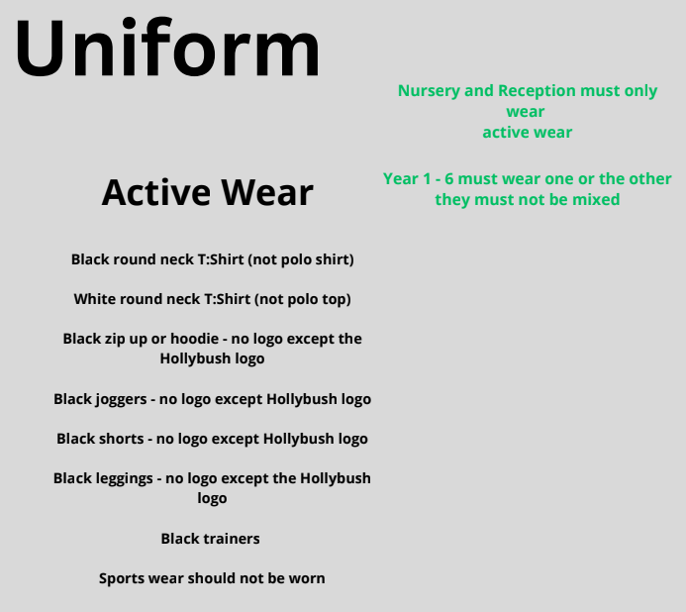
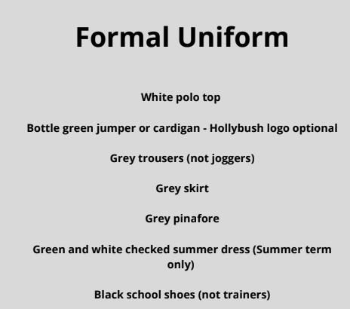
Hair longer than shoulder length must be tied back everyday.
Uniforms must not be mix and matched For example green jumpers must not be worn with black bottoms.

Slide 4

PE days
Tuesday and Friday
Earrings need to be removed for PE.

Slide 5
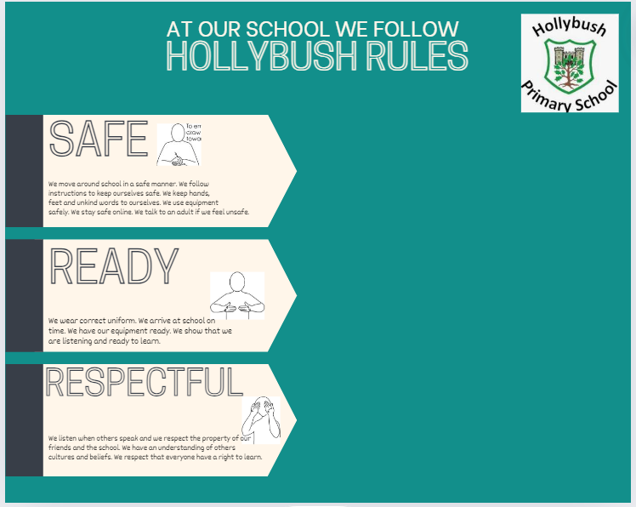
School Rules

Slide 6
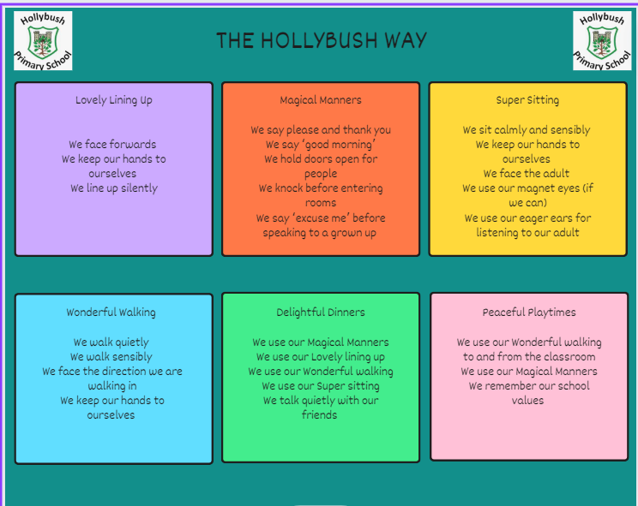
Behaviour

Slide 7

Values

Slide 8
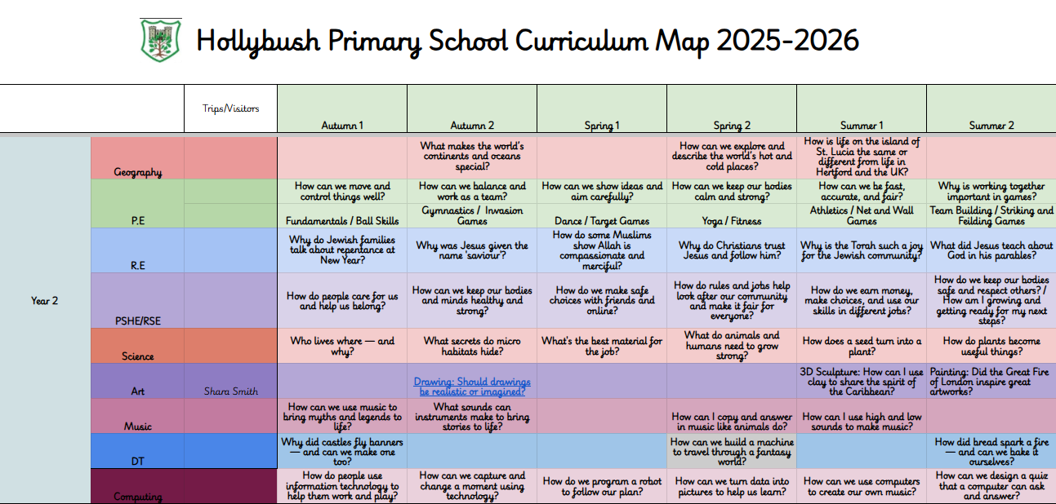
What will your child be learning?

Slide 9
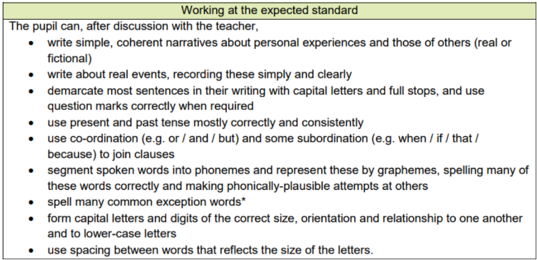
Writing

Slide 10
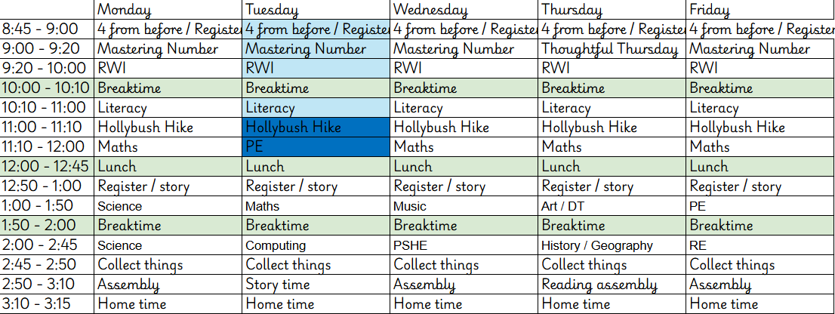
Timetable for this term

Slide 11
What can you do to support your child?
Reading – daily 10 minutes and complete the book.
TTRS – 10 minutes daily
Handwriting – essential it is correctly formed.
Attendance
Punctuality

Slide 12
E-safety KS1/ KS2
• Children must not publish images of other pupils
• Please ensure your child is using their device under your supervision
• Minimum ages for Instagram (13+), WhatsApp (16+), Facebook (13+),
Snapchat (13+)
• We will contact you if we suspect a pupil is misusing their device
• Talk about your child’s eSafety with them so they know they can come to
you or any school adult with problems
• It is important that pupils feel safe to discuss worries and that they will
not lose access to their device if they do make a mistake

Slide 13
How will we communicate with you?
Arbor
Social media -facebook and instagram
Phone calls
Newsletter (fortnightly)
Website
Make sure we have up to date contact details

Slide 14
Other information
Autumn
Trip to Stansted Mount Fitchett Castle – letter coming out.
Summer Term
Phonics Screening Check for those who may not have reached the required mark.

Slide 15
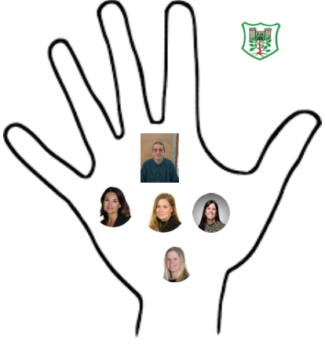
Safeguarding
Safeguarding is everyone's responsibility.
Mr Fisher- Designated Safeguarding Lead
Mrs Cracknell- Deputy Designated Safeguarding Lead
Miss Borgeat- Deputy Designated Safeguarding Lead
Mrs Richardson- Deputy Designated Safeguarding Lead
Mrs Sally Poole-Deputy Designated Safeguarding Lead

