Slide 1

Welcome to Year 5
Mrs Ahmed and Mrs Botterman

Slide 2
What do you need for Year 5
Water bottle
Named clothing
OPAL- need wellies and rain clothes- out in all weather! The children need to change when they come in if they are covered in mud or are too wet. (we don’t have facilities to dry clothes)
Uniform reminder - check the school website. We will send children to the office for spare items of school uniform if what they are wearing is not appropriate.
Hair bands - hair below shoulder length must be tied back
Children need to wear active wear or PE kit for PE, which is on a Monday and Friday
Children may bring in a pencil case which fits in their drawer and has no attachments.

Slide 3
Google Classroom
Google classroom logins are the same as their login details for the chromebooks at school
These details will be stuck on the back of their reading record books by next week
Homework will be set via google classroom weekly - spellings

Slide 4
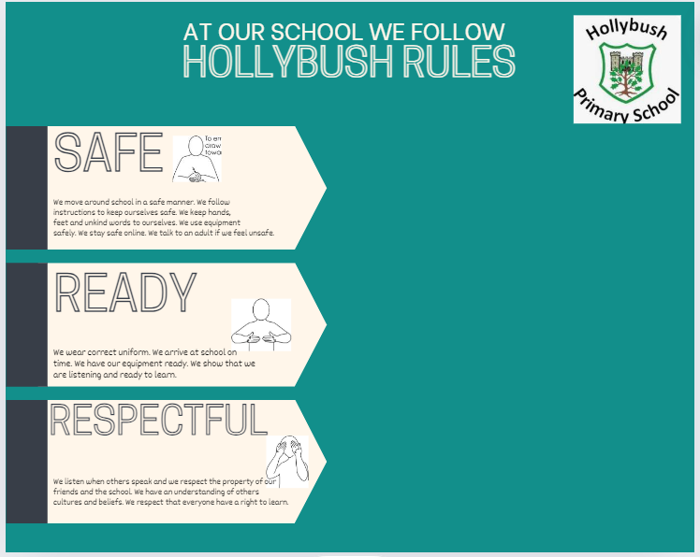
School Rules

Slide 5
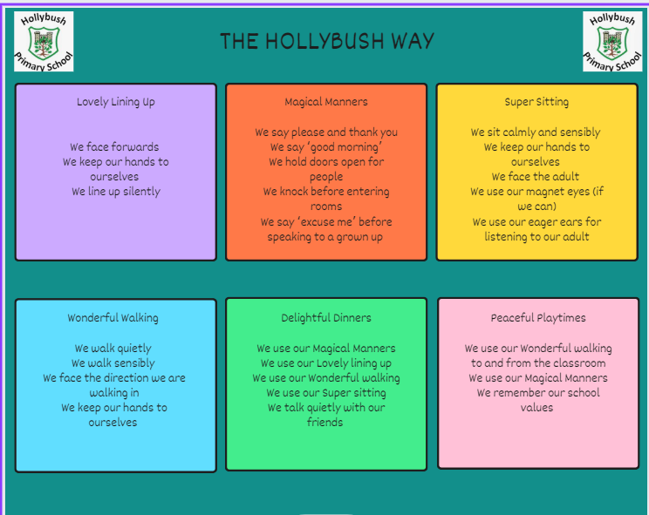
Behaviour

Slide 6

Values

Slide 7
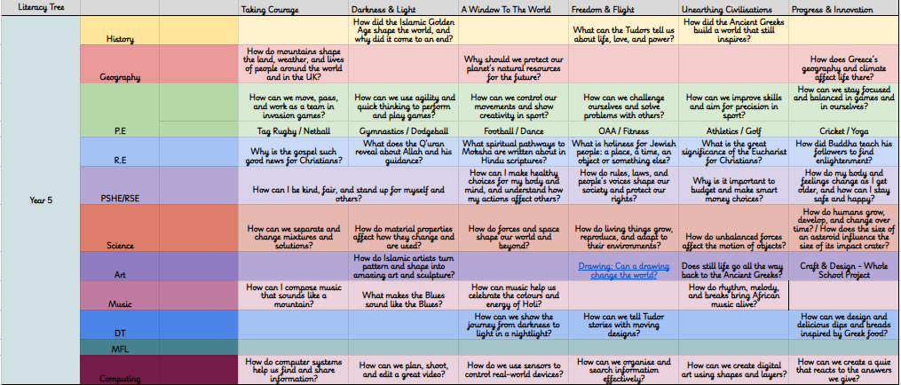
What will your child be learning?

Slide 8
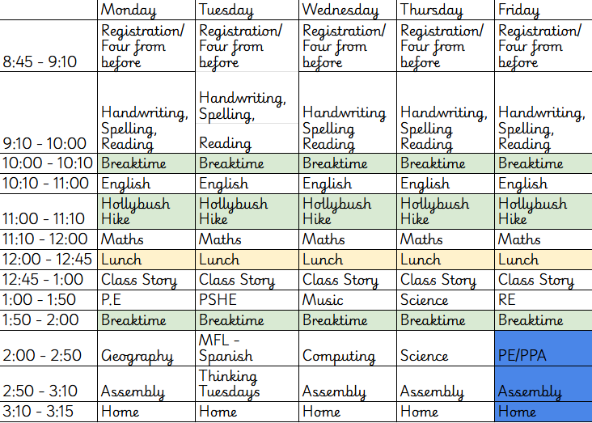
Timetable for this term

Slide 9
Homework
Ten spellings are given weekly from the common exception word list year 5 & 6.
If this is too many for your child please let us know the amount that they would feel more comfortable with.

Slide 10
What can you do to support your child?
Spelling
Reading
TTRS
Attendance
Punctuality
Timings of the day
Avoid late night games
Unhealthy snacks
In bed on time
Breakfast

Slide 11
E-safety KS1/ KS2
• Children must not publish images of other pupils
• Please ensure your child is using their device under your supervision
• Minimum ages for Instagram (13+), WhatsApp (16+), Facebook (13+),
Snapchat (13+)
• We will contact you if we suspect a pupil is misusing their device
• Talk about your child’s eSafety with them so they know they can come to
you or any school adult with problems
• It is important that pupils feel safe to discuss worries and that they will
not lose access to their device if they do make a mistake

Slide 12
How will we communicate with you?
Arbor
Social media -facebook and instagram
Phone calls
Newsletter (fortnightly)
Website
Are your contact details up to date?

Slide 13
Other information
Trips
Summative end of term tests
Concerns - direct to us, please don’t use social media
Email should go through admin and will be sent on
(remember our working days are; Mrs Ahmed Monday-Wednesday, Mrs Botterman Thursday and Friday. We meet together after school on a Wednesday for the staff meeting and any other business.

Slide 14
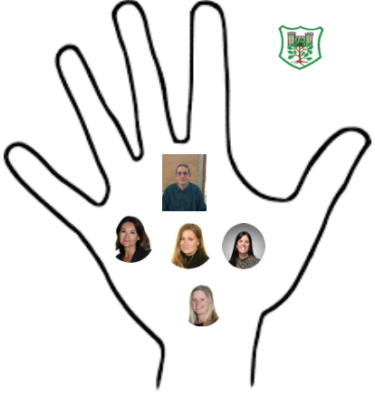
Safeguarding
Safeguarding is everyone's responsibility.
Mr Fisher- Designated Safeguarding Lead
Mrs Cracknell- Deputy Designated Safeguarding Lead
Miss Borgeat- Deputy Designated Safeguarding Lead
Mrs Richardson- Deputy Designated Safeguarding Lead
Mrs Sally Poole-Deputy Designated Safeguarding Lead

Slide 15
Questions?

