Slide 1
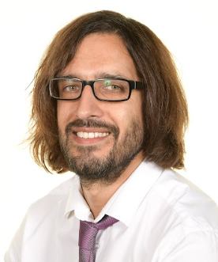

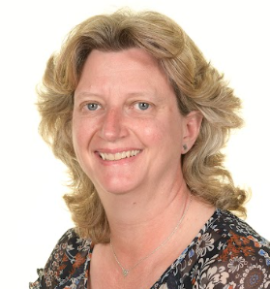
Welcome to Year 6
Mr Mallick and Mrs Smith
With
Nick and Lily

Slide 2

What do you need for Year 6
Water bottle(with only water on it)
Named clothing
OPAL- need wellies and rain clothes- out in all weather!
Correct uniform
Hair bands for long hair
Brick phones only

Slide 3
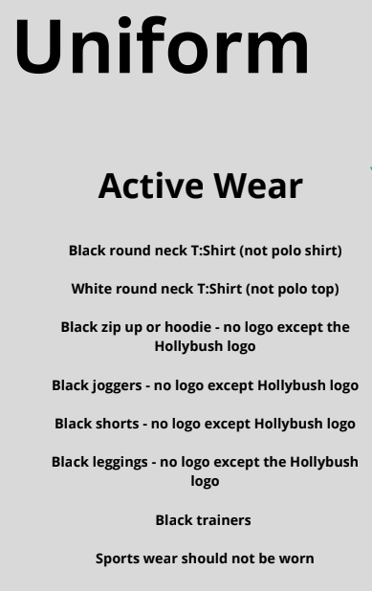
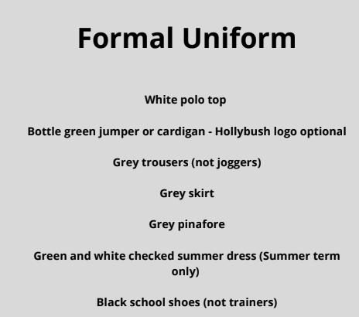
Hair longer than shoulder length must be tied back everyday.
Uniforms must not be mix and matched For example green jumpers must not be worn with black bottoms.

Slide 4
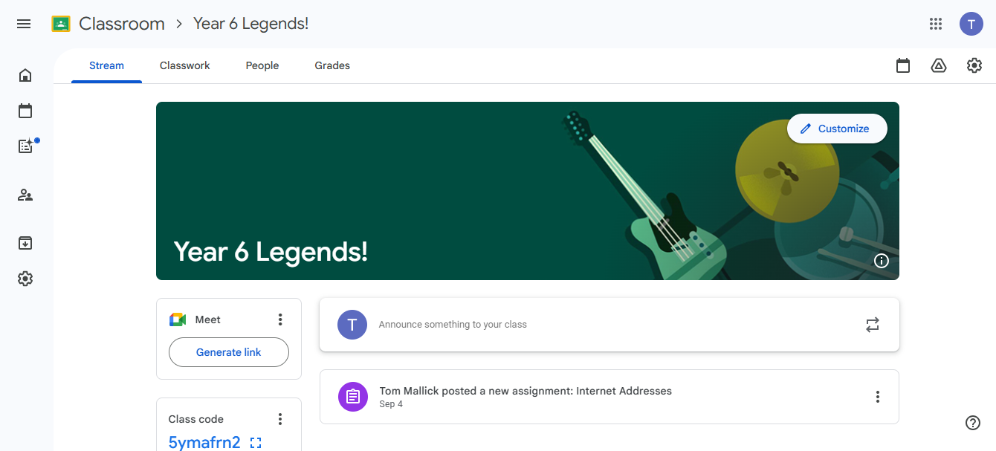
Google Classroom

Slide 5
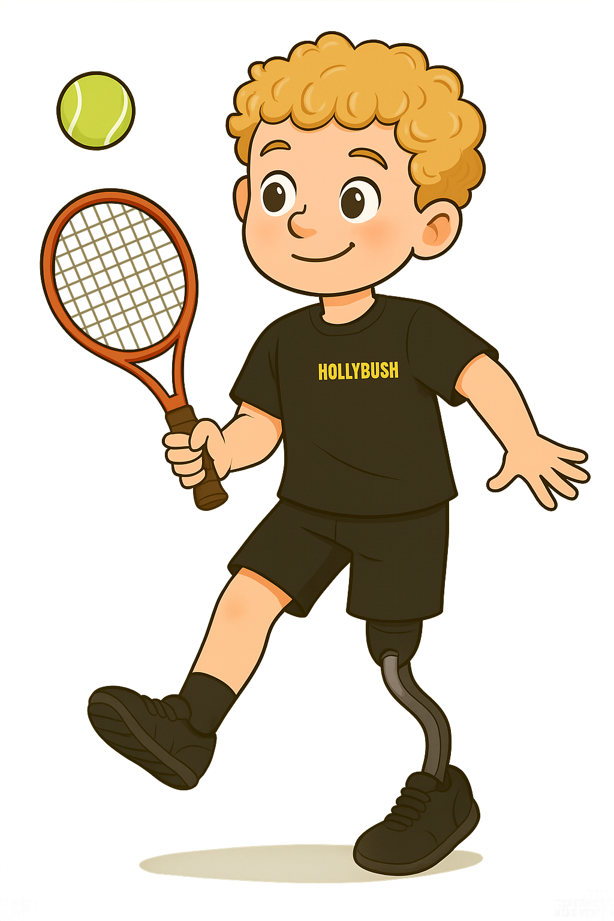
PE days
PE will be with Matt on Tuesday and me on Thursday. Try to ensure the children have appropriate active wear on these days.

Slide 6
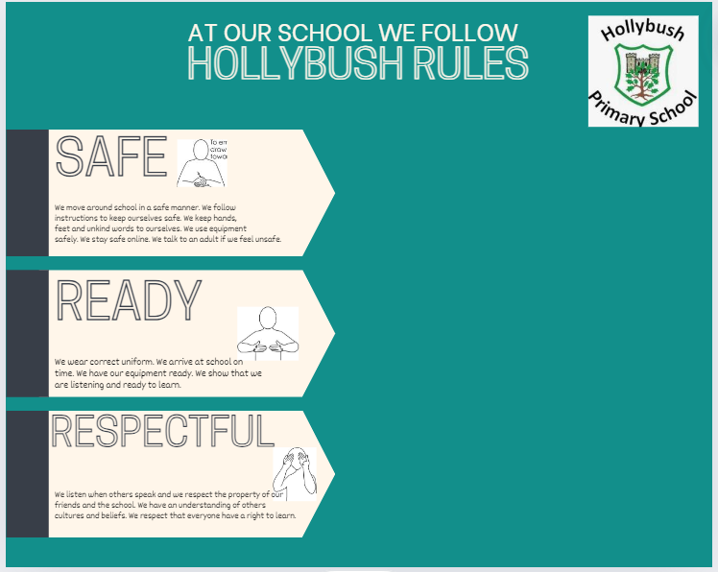
School Rules

Slide 7
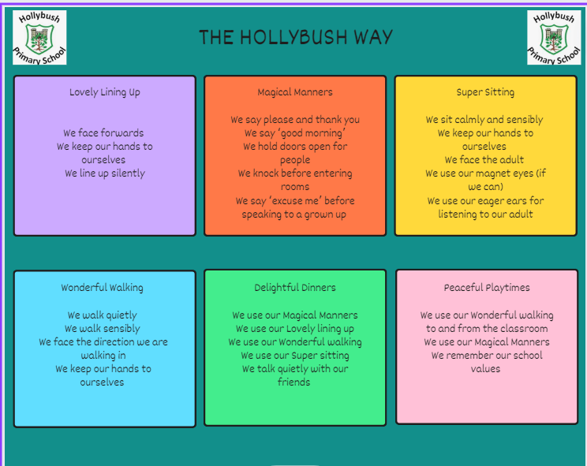
Behaviour

Slide 8

Values

Slide 9
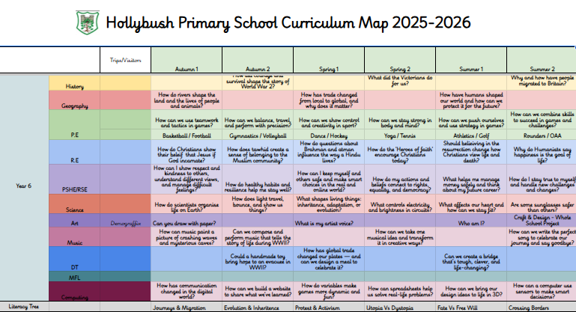
What will your child be learning?

Slide 10
Timetable for this term
 | Monday | Tuesday | Wednesday | Thursday | Friday
8:45 - 9:10 | Registration/ Four from before | Registration/ Four from before | Registration/ Four from before | Registration/ Four from before | Registration/ Four from before
9:10 - 10:00 | Handwriting, Spelling, Reading | Handwriting, Spelling, Reading | Handwriting Spelling Reading | English | HandwritingS pelling Reading
10:00 - 10:10 | Breaktime | Breaktime | Breaktime | Breaktime | Breaktime
10:10 - 11:00 | English | English | English | PE | English
11:00 - 11:10 | Hollybush Hike | Hollybush Hike | Hollybush Hike | Hollybush Hike | Hollybush Hike
11:10 - 12:00 | Maths | Maths | Maths | Maths | Maths
12:00 - 12:45 | Lunch | Lunch | Lunch | Lunch | Lunch
12:45 - 1:00 | Class Story | Class Story | Class Story | Class Story | Class Story
1:00 - 1:50 | RE | PPA - JS MFL | Science | Geography | Computing
1:50 - 2:00 | Breaktime | Breaktime | Breaktime | Breaktime | Breaktime
2:00 - 2:50 | Art | PPA - Matt P.E | Science | PHSE | Music
2:50 - 3:10 | Assembly |  | Assembly | Thoughtful Thursday | Assembly
3:10 - 3:15 | Home | Home | Home | Home | Home

Slide 11
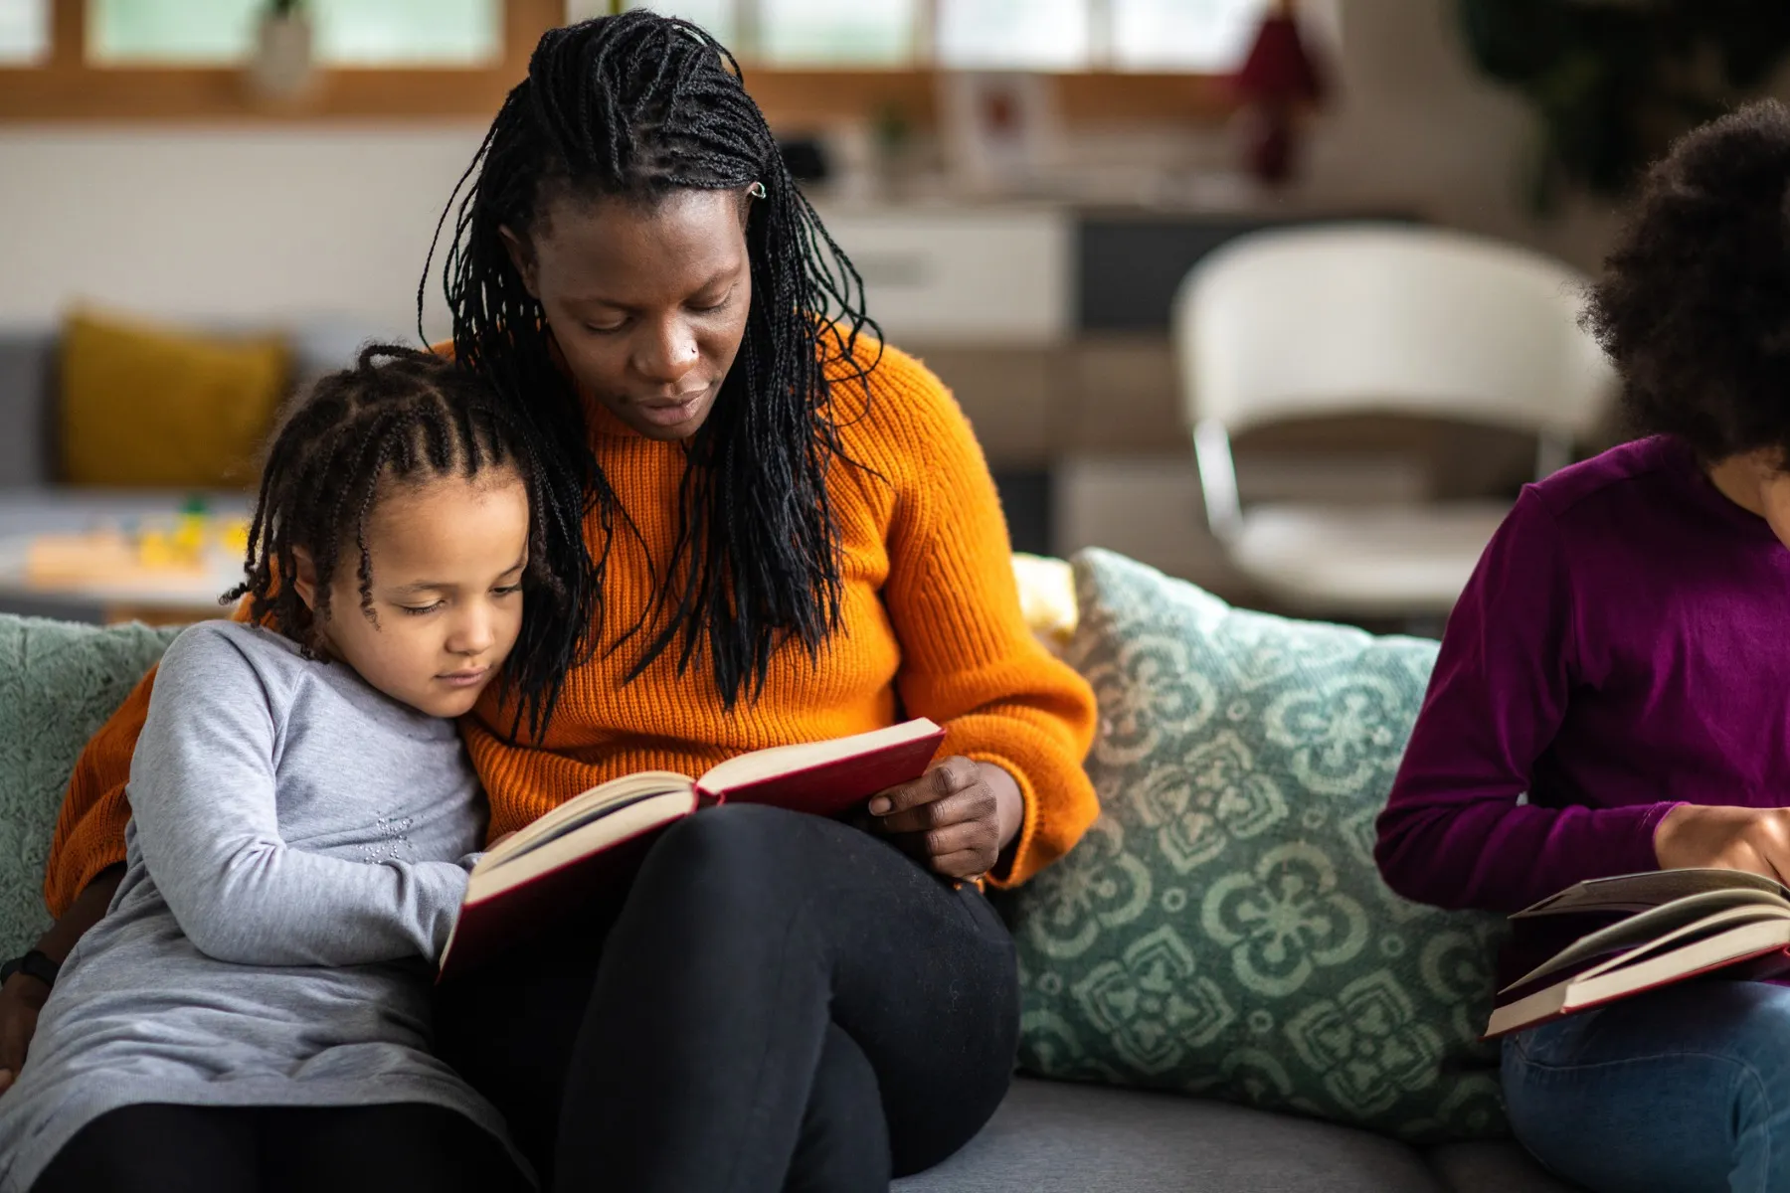
What can you do to support your child?
Spelling
Reading
TTRS
Attendance
Punctuality
Encourage and support with
homework and revision tasks
Limit time online
Good diet and plenty of sleep
Exercise

Slide 12

E-safety KS2
Children must not publish images of other pupils
Please ensure your child is using their device under your supervision
Minimum ages for Instagram (13+), WhatsApp (16+), Facebook (13+),
Snapchat (13+)
We will contact you if we suspect a pupil is misusing their device
Talk about your child’s eSafety with them so they know they can come to
you or any school adult with problems
It is important that pupils feel safe to discuss worries and that they will
not lose access to their device if they do make a mistake
Please monitor the time and content of your child’s online life

Slide 13

How will we communicate with you?
Arbor - email and text
Social media -facebook and instagram
Phone calls
Newsletter (fortnightly)
Website
Face-to-face where possible
School reports
Parent consultations and Stepping Stones meetings
Make sure we have up to date contact details

Slide 14
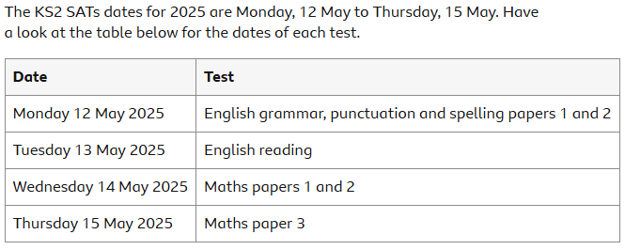
Other information
PGL - meeting after this
SATS week
Hertford Museum Trip WWII - tbc
concerns - direct to us, please don’t use social media

Slide 15
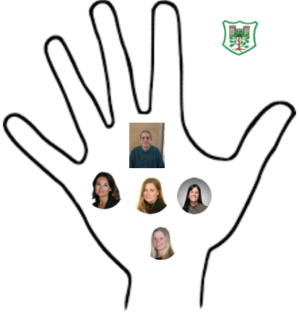
Safeguarding
Safeguarding is everyone's responsibility.
Mr Fisher- Designated Safeguarding Lead
Mrs Cracknell- Deputy Designated Safeguarding Lead
Miss Borgeat- Deputy Designated Safeguarding Lead
Mrs Richardson- Deputy Designated Safeguarding Lead
Mrs Sally Poole-Deputy Designated Safeguarding Lead

Slide 16
Thank you for coming!
Any questions?

