Slide 1

Welcome to Year 4
Ian Chandler, Jill Eley, Ossy Brown, Elliott Williams

Slide 2
What do you need for Year 4
water bottle
named clothing
OPAL- need wellies and rain clothes- out in all weather!
correct uniform
hair bands for long hair

Slide 3
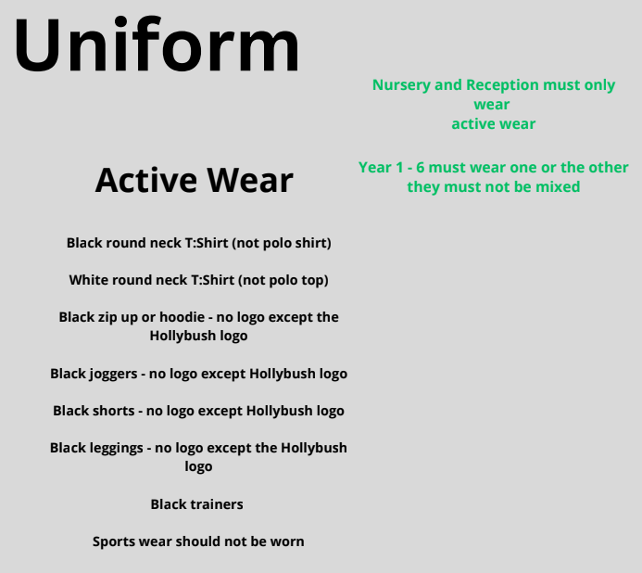
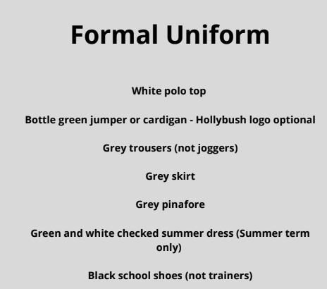
Hair longer than shoulder length must be tied back everyday.
Uniforms must not be mix and matched For example green jumpers must not be worn with black bottoms.

Slide 4
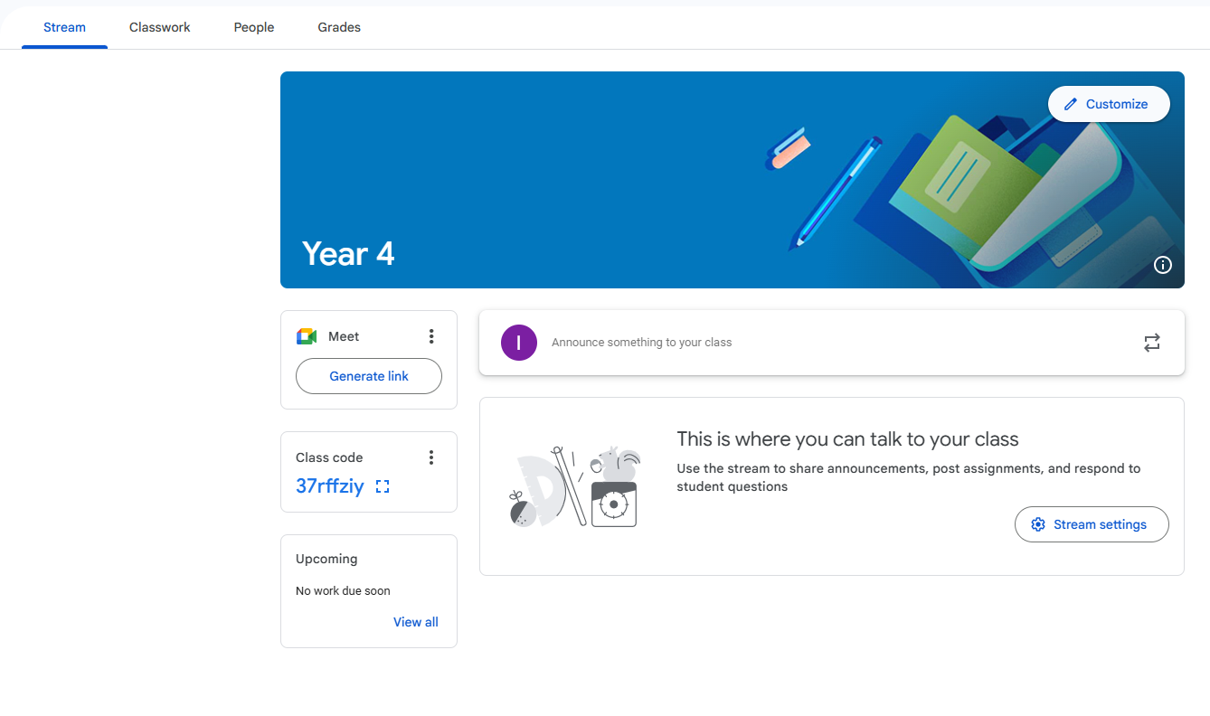
Google Classroom

Slide 5
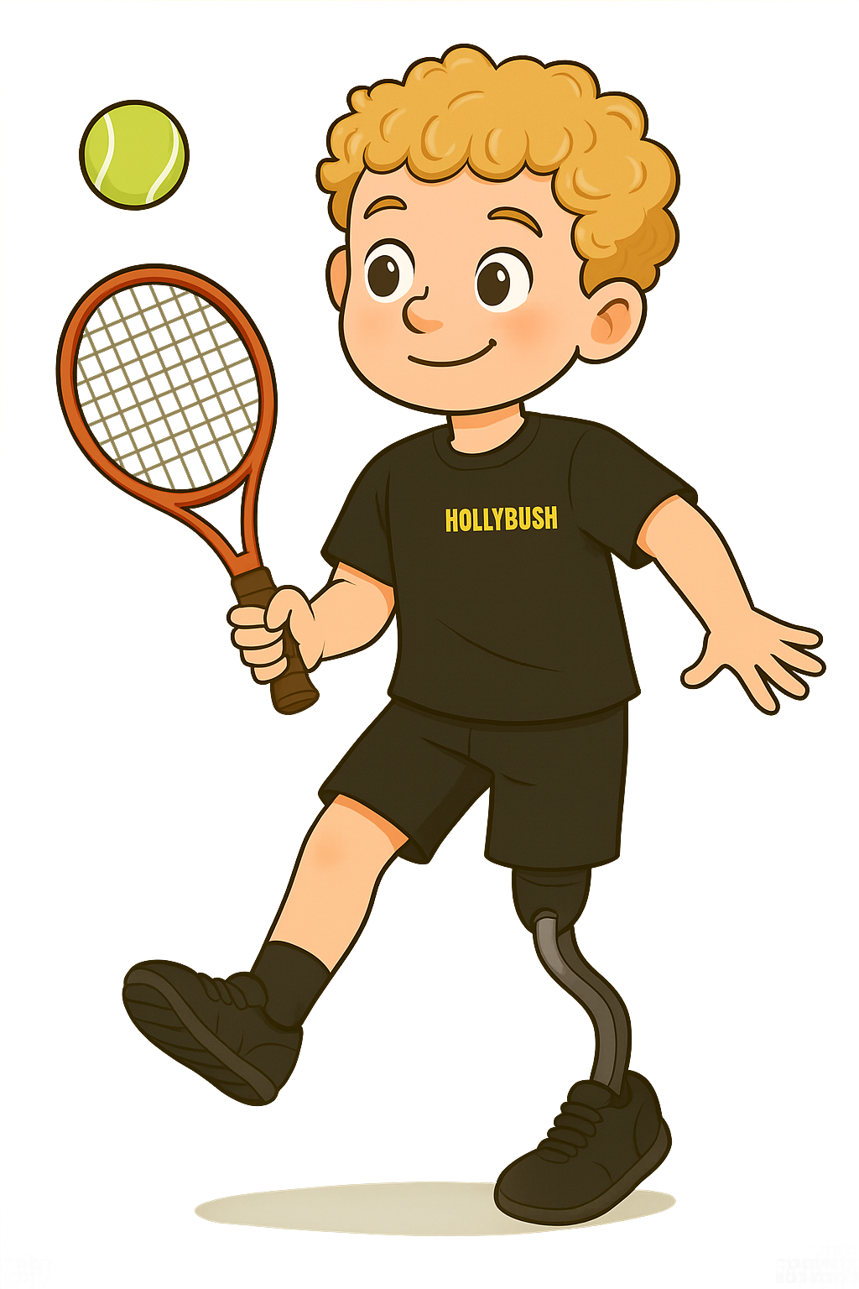
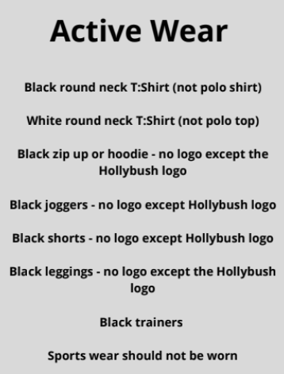
PE days
Thursday and Friday. Please ensure the children have appropriate active wear on these days.

Slide 6
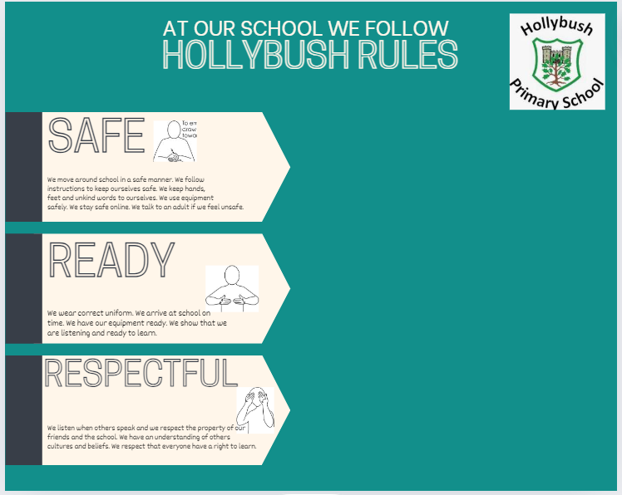
School Rules

Slide 7
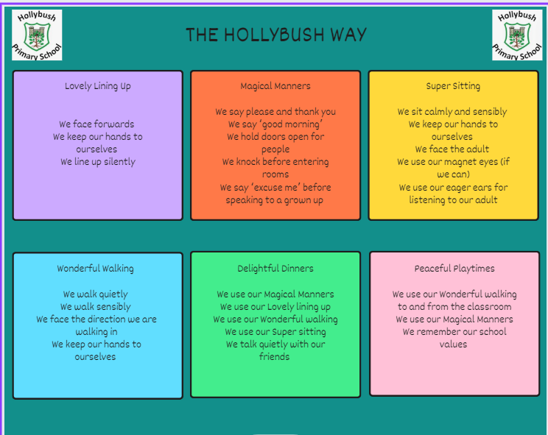
Behaviour

Slide 8
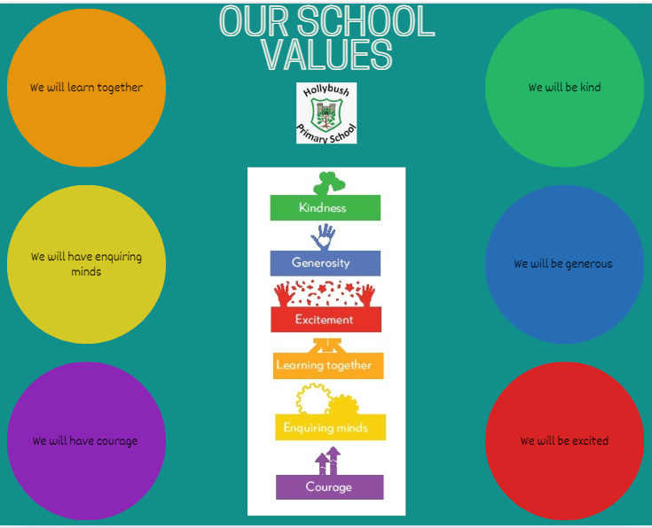
Values

Slide 9
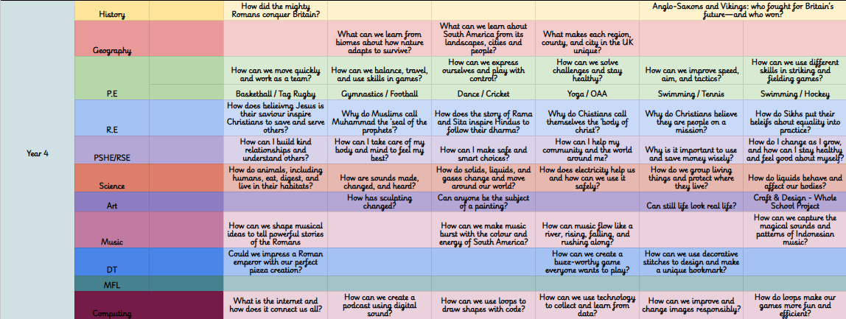
What will your child be learning?
Long term planning overview

Slide 10
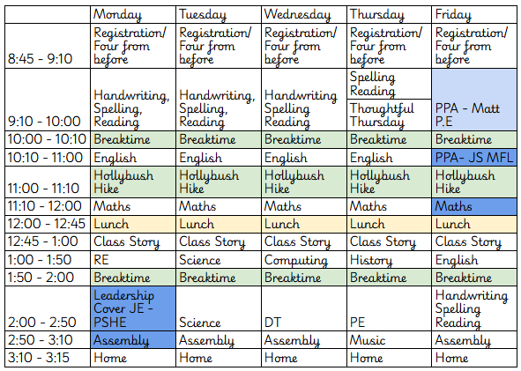
Weekly timetable for this term

Slide 11
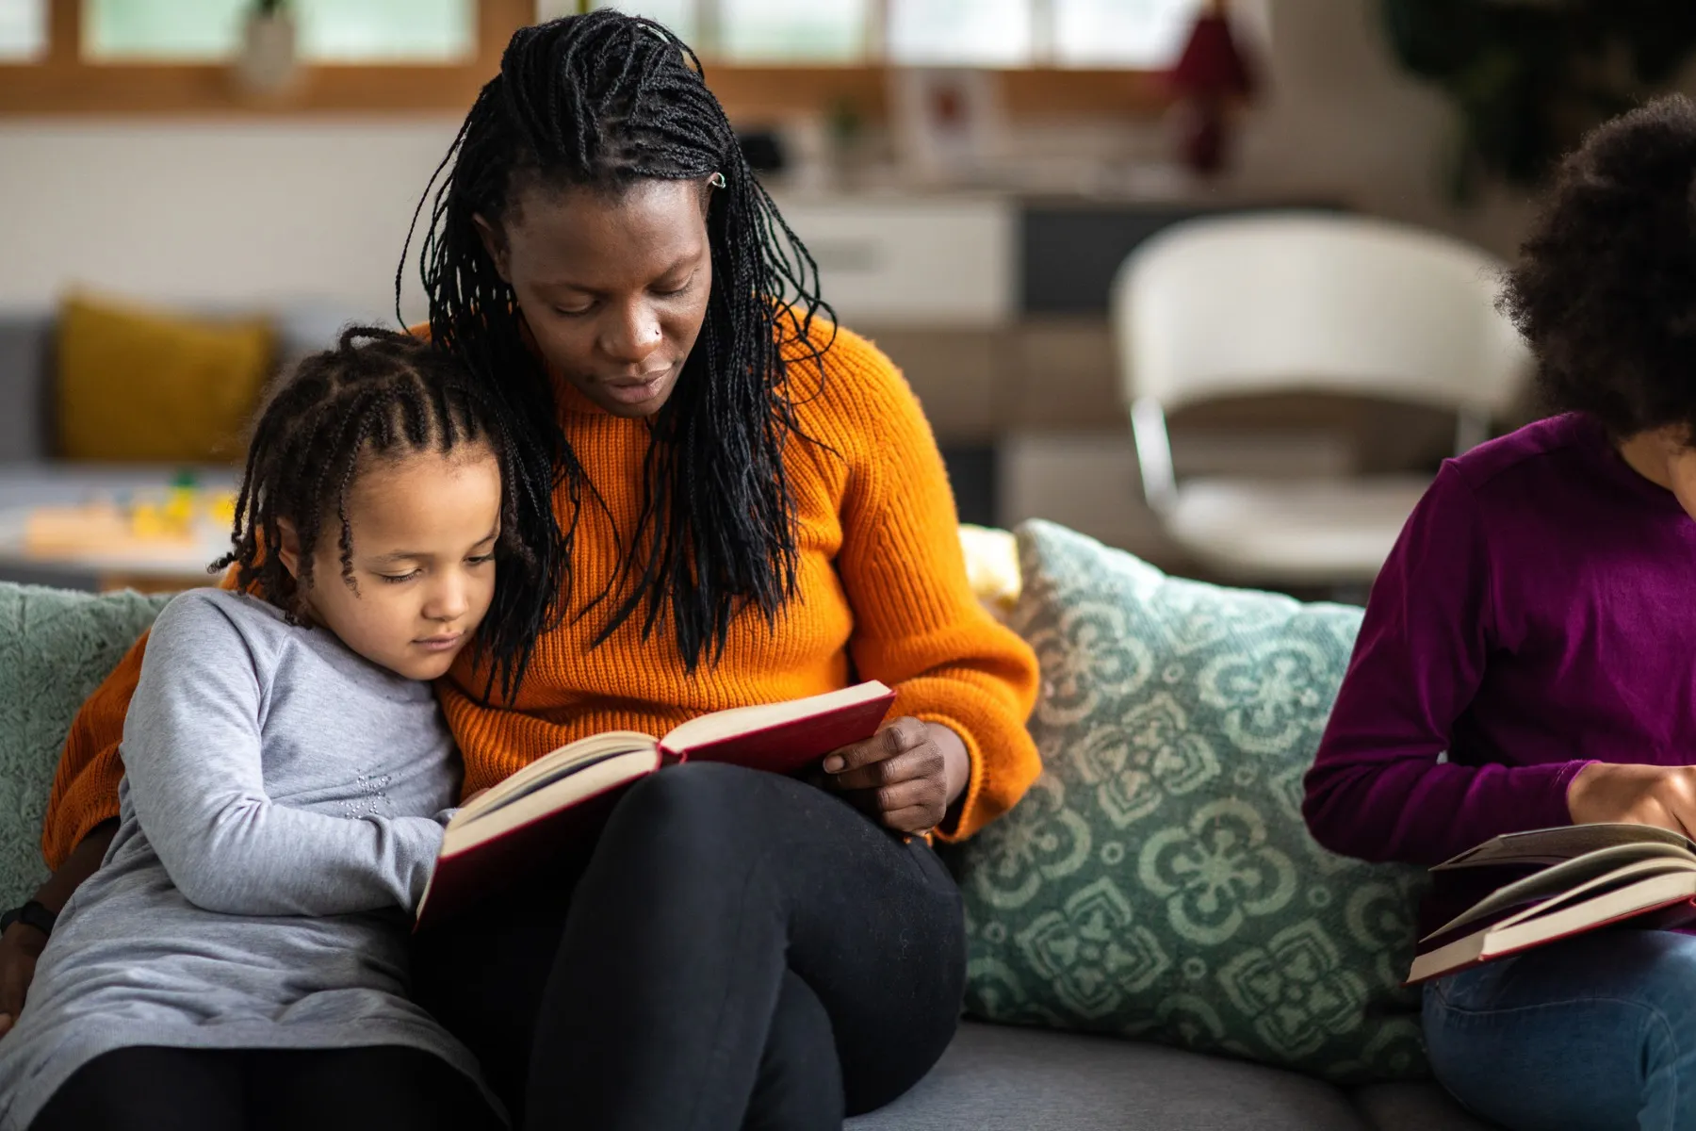
What can you do to support your child?
Spelling
Reading
TTRS
Attendance
Punctuality
Encourage and support with homework
Limit time online
Good diet and plenty of sleep
Exercise

Slide 12

E-safety/online safety KS2
Children must not publish images of other pupils
Please ensure your child is using their device under your supervision
Minimum ages for Instagram (13+), WhatsApp (16+), Facebook (13+),
Snapchat (13+)
We will contact you if we suspect a pupil is misusing their device
Talk about your child’s eSafety with them so they know they can come to
you or any school adult with problems
It is important that pupils feel safe to discuss worries and that they will
not lose access to their device if they do make a mistake
Please monitor the time and content of your child’s online life

Slide 13

How will we communicate with you?
Arbor
Social media - facebook and instagram
Phone calls, emails, texts
Newsletter (fortnightly)
Website
Face-to-face where possible
School reports
Parent consultations and Stepping Stones meeting
Please make sure we have up to date contact details

Slide 14

Other information
Autumn term trip to Verulamium Museum on Thursday 16th October
MTC - Multiplication Tables Check
The multiplication tables check (MTC) is statutory for all year 4 students in England*. It takes place annually in June, and helps to determine whether students can recall their times tables fluently.
concerns - direct to us, please don’t use social media

Slide 15
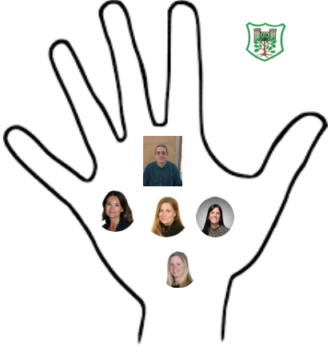
Safeguarding
Safeguarding is everyone's responsibility.
Mr Fisher - Designated Safeguarding Lead
Mrs Cracknell - Deputy Designated Safeguarding Lead
Miss Borgeat - Deputy Designated Safeguarding Lead
Mrs Richardson - Deputy Designated Safeguarding Lead
Mrs Sally Poole - Deputy Designated Safeguarding Lead

Slide 16
Thank you for coming!
Any questions?

