Slide 1

Welcome to Year 3
Mrs Christman, Miss Tamzin, Mr Daniel and Mr Yeowell

Slide 2
What do you need for Year 3
Water bottle
Named clothing
OPAL- need wellies and rain clothes- out in all weather!
Uniform reminder
Hair bands
Reading book in school every day

Slide 3
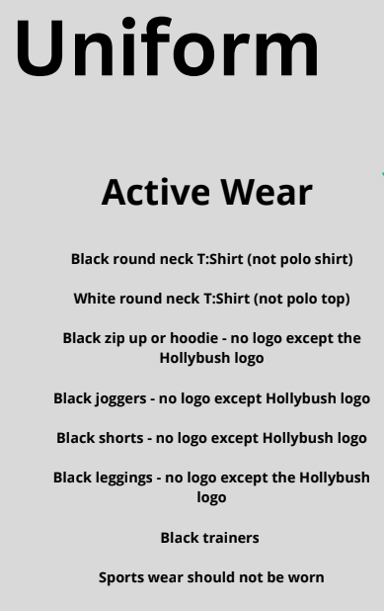
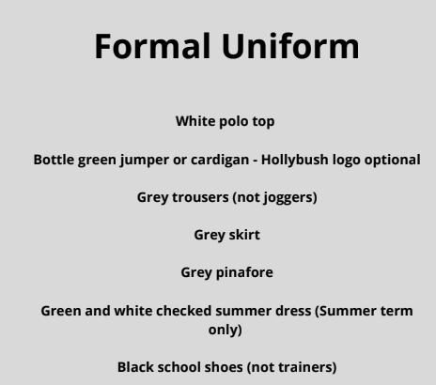
Hair longer than shoulder length must be tied back everyday.
Uniforms must not be mix and matched For example green jumpers must not be worn with black bottoms.

Slide 4
Google Classroom

Slide 5
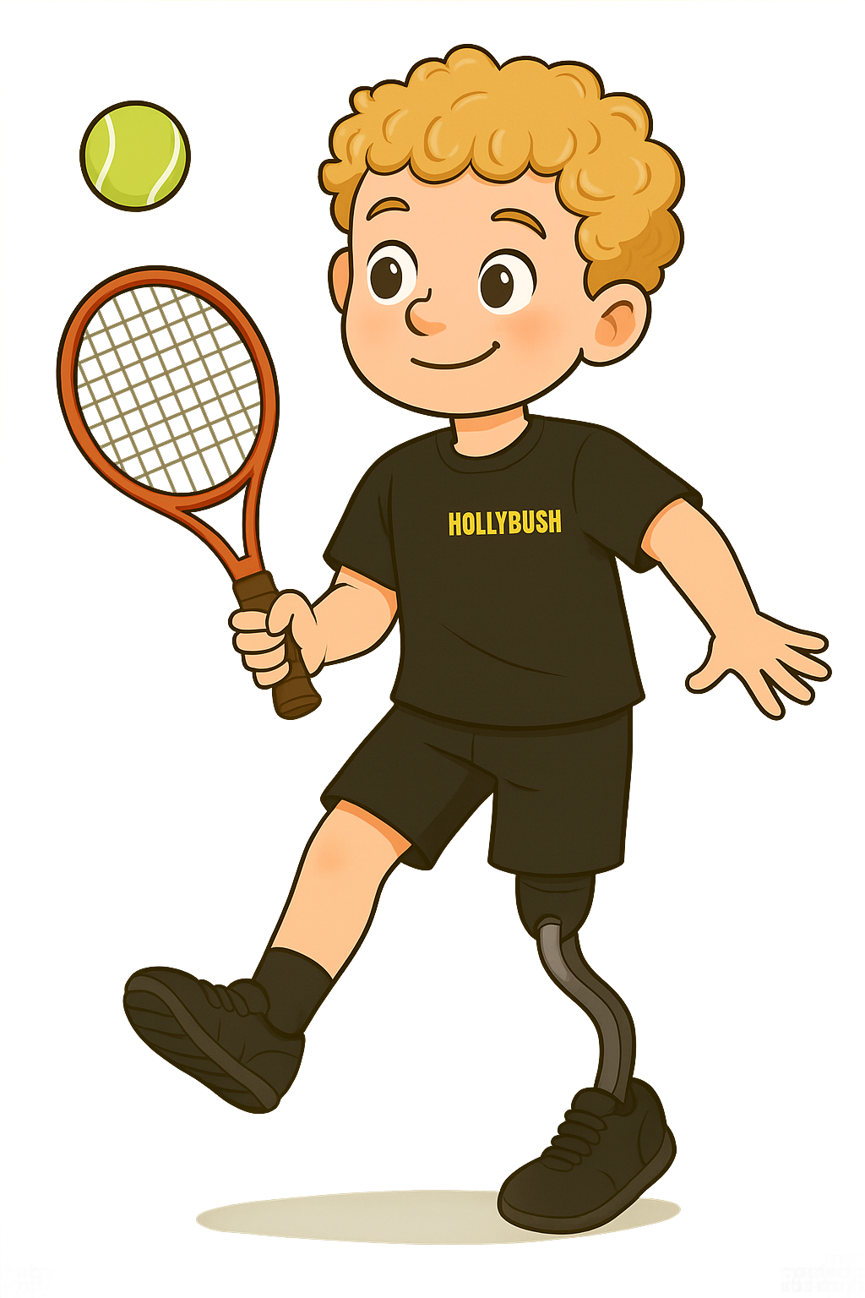
PE days
Matt on a Tuesday afternoon
Mrs Christman on a Thursday afternoon
The children need to wear active wear and trainers.

Slide 6
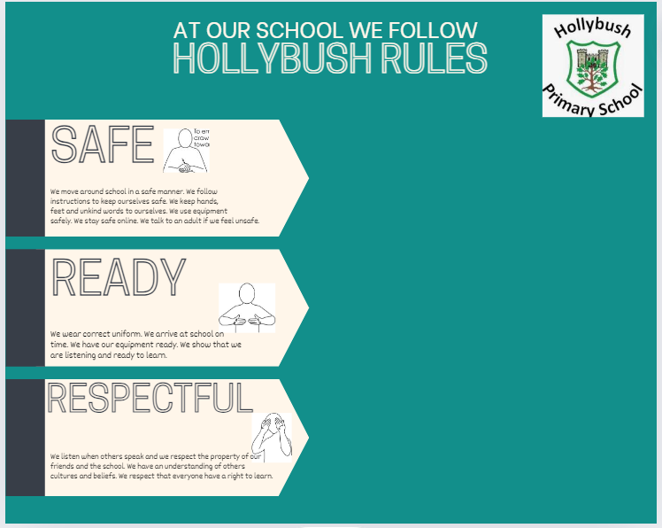
School Rules

Slide 7
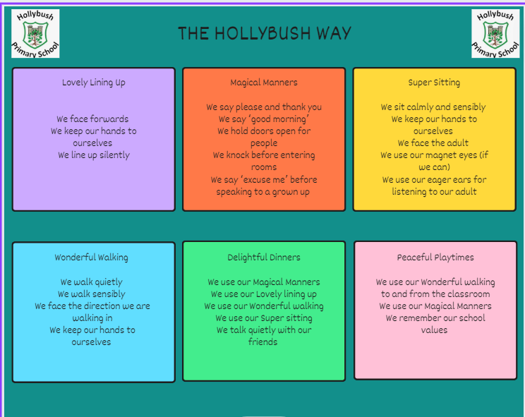
Behaviour

Slide 8
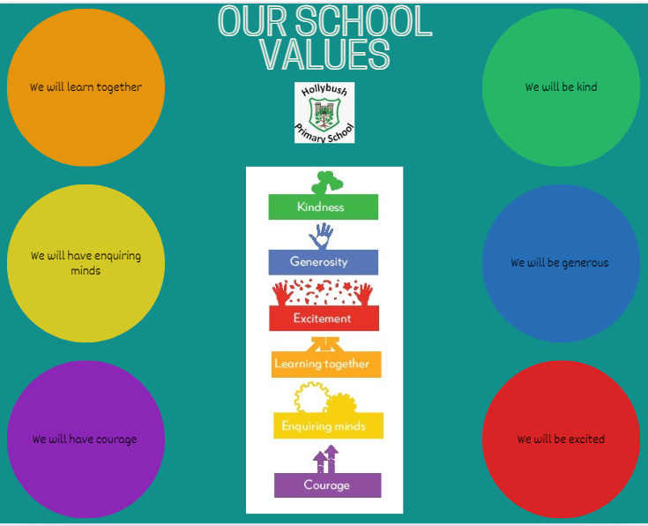
Values

Slide 9
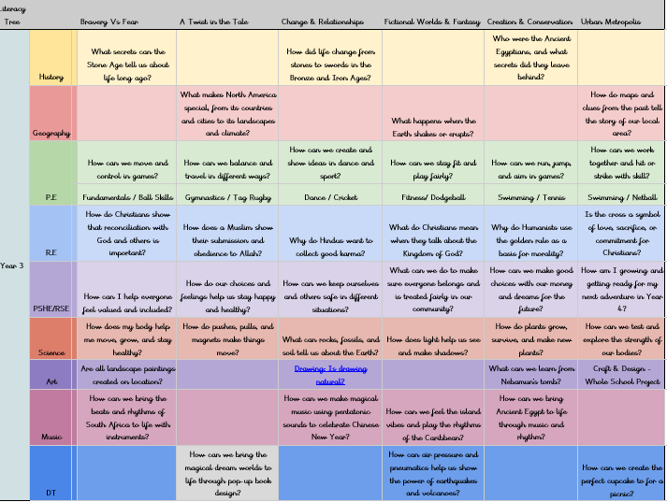
What will your child be learning?

Slide 10
This term:
Bravery Vs Fear | A Twist in the Tale
What secrets can the Stone Age tell us about life long ago?
 | What makes North America special, from its countries and cities to its landscapes and climate?
How can we move and control in games? | How can we balance and travel in different ways?
Fundamentals / Ball Skills | Gymnastics / Tag Rugby
How do Christians show that reconciliation with God and others is important? | How does a Muslim show their submission and obedience to Allah?
How can I help everyone feel valued and included? | How do our choices and feelings help us stay happy and healthy?
How does my body help me move, grow, and stay healthy? | How do pushes, pulls, and magnets make things move?
Are all landscape paintings created on location?
How can we bring the beats and rhythms of South Africa to life with instruments?
 | How can we bring the magical dream worlds to life through pop-up book design?
How do computers work together to share information? | How can we tell a story using stop-motion animation?

Slide 11
Timetable for this term
 | Monday | Tuesday | Wednesday | Thursday | Friday
8:45 - 9:10 | Registration/ Four from before | Registration/ Four from before | Registration/ Four from before | Registration/ Four from before | Registration/ Four from before
9:10 - 10:00 | Handwriting, Spelling, Reading | Handwriting, Spelling, Reading | Handwriting Spelling Reading | Spelling Reading | Handwriting Spelling Reading
 |  |  |  | Thoughtful Thursday
10:00 - 10:10 | Breaktime | Breaktime | Breaktime | Breaktime | Breaktime
10:10 - 11:00 | English | English | English | English | English
11:00 - 11:10 | Hollybush Hike | Hollybush Hike | Hollybush Hike | Hollybush Hike | Hollybush Hike
11:10 - 12:00 | Maths | Maths | Maths | Maths | Maths
12:00 - 12:45 | Lunch | Lunch | Lunch | Lunch | Lunch
12:45 - 1:00 | Class Story | PPA- P.E. with Matt | Class Story | Class Story | Class Story
1:00 - 1:50 | Computing |  | RE | P.E | History
1:50 - 2:00 | Breaktime | Breaktime | Breaktime | Breaktime | Breaktime
2:00 - 2:50 | Art | PPA Cover KR - PSHE | Leadership-KR MFL | Science | Music
2:50 - 3:10 | Assembly | Assembly | Assembly |  | Assembly
3:10 - 3:15 | Home | Home | Home | Home | Home

Slide 12
What can you do to support your child?
Spelling will be sent home by google classroom.
Reading- 10 minutes every night
TTRS- 10 minutes every night (log in details in reading record)
Challenge tasks will be added to google classroom every week
Attendance
Punctuality

Slide 13
E-safety KS2
• Children must not publish images of other pupils
• Please ensure your child is using their device under your supervision
• Minimum ages for Instagram (13+), WhatsApp (16+), Facebook (13+),
Snapchat (13+)
• We will contact you if we suspect a pupil is misusing their device
• Talk about your child’s eSafety with them so they know they can come to
you or any school adult with problems
• It is important that pupils feel safe to discuss worries and that they will
not lose access to their device if they do make a mistake

Slide 14
How will we communicate with you?
Arbor - Key communications (e.g. daily messages, letters) and is also how you will make any necessary payments to the school.
Social Media – Like and follow Hollybush Primary School on Facebook and Instagram
Newsletter – The Hollybush Bulletin emailed home fortnightly
We will be available to speak to you before/ after school but please be aware this is often a busy time. We are always happy to call or email you or arrange a suitable time for a meeting (face to face or via phone call).
concerns - direct to us, please don’t use social media

Slide 15
Other information
Trips -TBC
Swimming. During the summer term. Day not yet decided. This will count as their second P.E day.

Slide 16
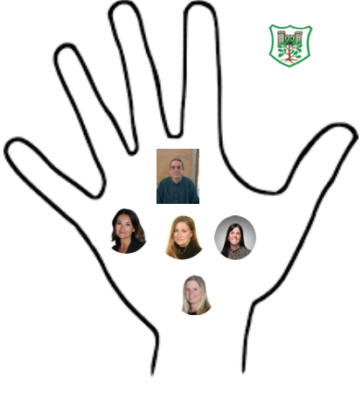
Safeguarding
Safeguarding is everyone's responsibility.
Mr Fisher- Designated Safeguarding Lead
Mrs Cracknell- Deputy Designated Safeguarding Lead
Miss Borgeat- Deputy Designated Safeguarding Lead
Mrs Richardson- Deputy Designated Safeguarding Lead
Mrs Sally Poole-Deputy Designated Safeguarding Lead

Slide 17
Thank you for coming!
Any questions?

