Slide 1

Welcome to The Nest
Miss Crane, Miss Santana, Miss Hirons

Slide 2
What do you need for The Nest
Water bottle
Snacks
Communication book
Change of clothes

Slide 3
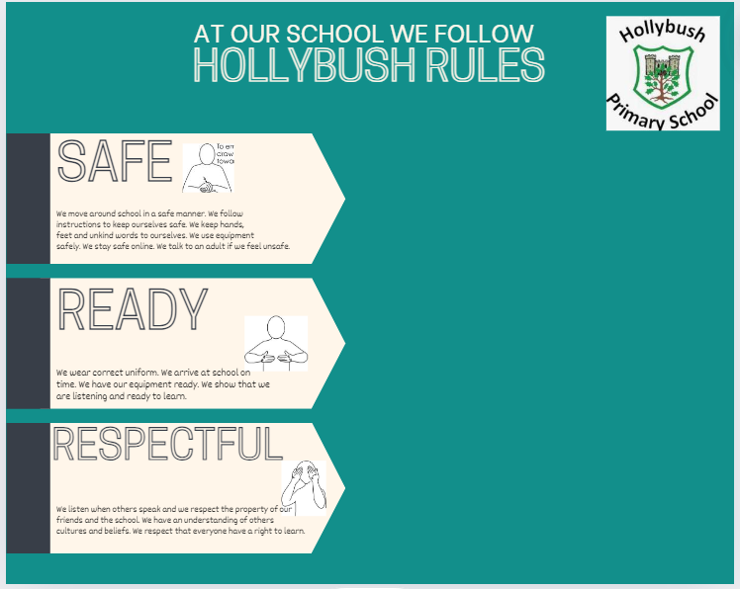
School Rules

Slide 4
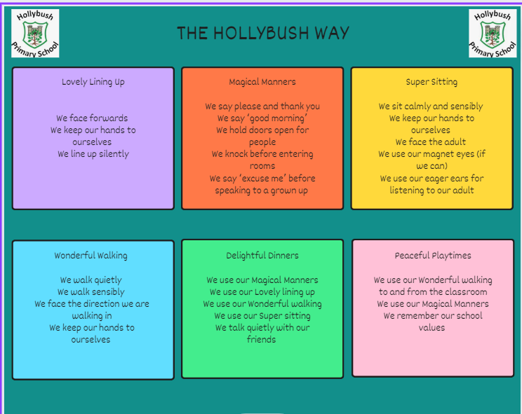
Behaviour

Slide 5

Values

Slide 6
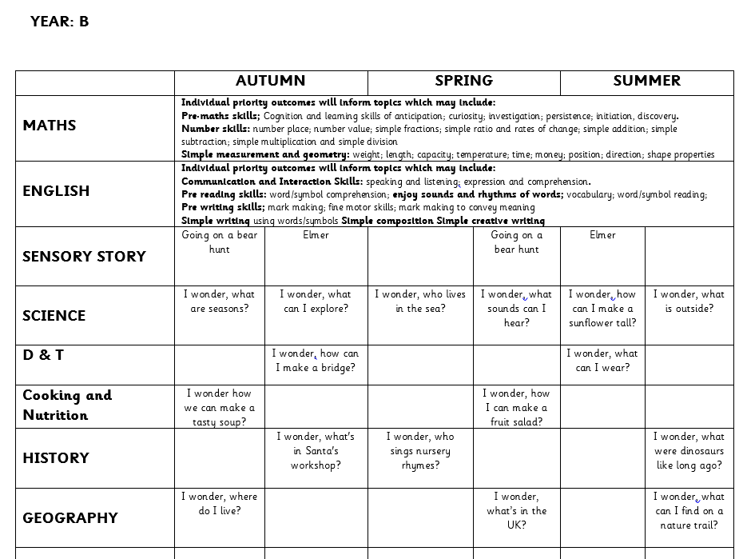
What will your child be learning?

Slide 7
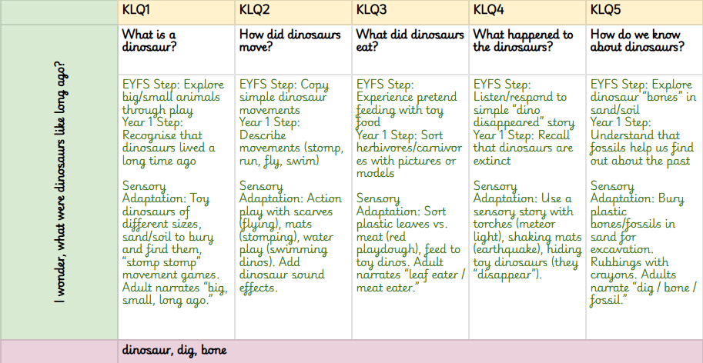
What does this look like?

Slide 8
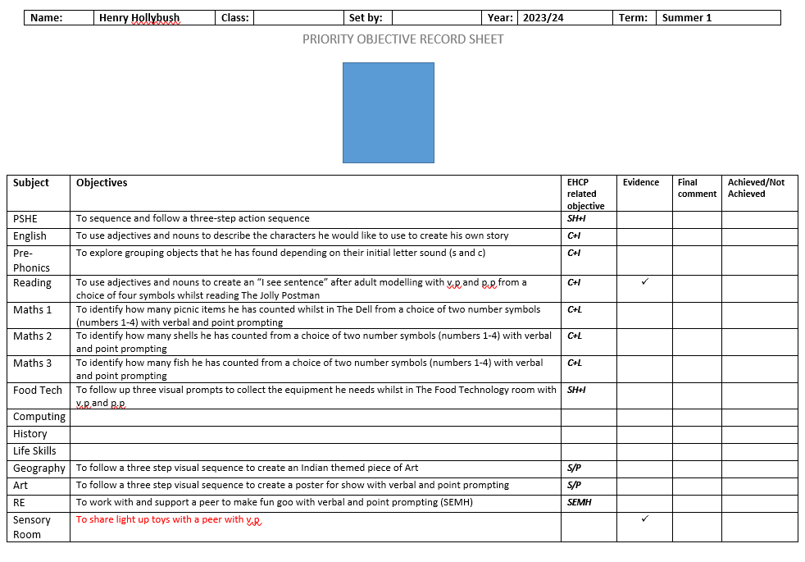
Individual Children’s targets

Slide 9
Timetable for this term:
 | Monday | Tuesday | Wednesday | Thursday | Friday
8:40 - 9:00 | Sensory Circuits | Sensory Circuits | Sensory Circuits | Sensory Circuits | Sensory Circuits
9:00 - 09:30 | Bucket time Stage 1 | Bucket time Stage 1 | Bucket time Stage 1 | Bucket time Stage 1 | Bucket time Stage 1
09:30- 11:15 | Bucket time Stage 2-3 | Bucket time Stage 2-3 | Bucket time Stage 2-3 | Bucket time Stage 2-3 | Bucket time Stage 2-3
8:40 - 9:00 | Brain Gym | Brain Gym | Brain Gym | Brain Gym | Brain Gym
8:40 - 9:00 | Food Tasting | Food Tasting | Food Tasting | Food Tasting | Food Tasting
8:40 - 9:00 | Snack Time | Snack Time | Snack Time | Snack Time | Snack Time
8:40 - 9:00 | Story | Story | Story | Story | Story
8:40 - 9:00 | Tidy Desks | Tidy Desks | Tidy Desks | Tidy Desks | Tidy Desks
8:40 - 9:00 | CIP / Toilet Time | CIP / Toilet Time | CIP / Toilet Time | CIP / Toilet Time | CIP / Toilet Time
8:40 - 9:00 | Table Time | Table Time | Table Time | Table Time | Table Time
8:40 - 9:00 | Music Time | Music Time | Music Time | Music Time | Music Time
8:40 - 9:00 | Singing Hands / Toilet Time | Singing Hands / Toilet Time | Singing Hands / Toilet Time | Singing Hands / Toilet Time | Singing Hands / Toilet Time
8:40 - 9:00 | Lunch Time | Lunch Time | Lunch Time | Lunch Time | Lunch Time
12:45 - 1:15 | Dough Disco | Dough Disco | Dough Disco | Dough Disco | PE with Matt
12:20 - 1:35 | Walk to class REC/Y1 | Walk to class REC/Y1 | Walk to class REC/Y1 | Walk to class REC/Y1 | Walk to class REC/Y1
 | Identiplay & Phonics - DJ | See & Learn | See & Learn |  | Walk to class REC/Y1

Slide 10
What can you do to support your child?
Fill out the communication book
Ensure they have a change of clothes and all of their things to support their regulation

Slide 11
How will we communicate with you?
Arbor
Social media -facebook and instagram
Phone calls
Newsletter (fortnightly)
Website
Evisense, Communication Books & See Saw (More info coming at Meet The Teacher!)
Make sure we have up to date contact details

Slide 12
Other information
Life skills trips (risk assessments)
School trips
EHCP meetings with Grace
If you have any concerns please direct them to us so we can support you please don’t use social media.
Email admin and I will try to get back to you within 2 working days.
We really appreciate the frustrations with the SEN system, outside agencies and we won’t always get things right, but know that we are here to work with you, and kindness goes a long way!

Slide 13
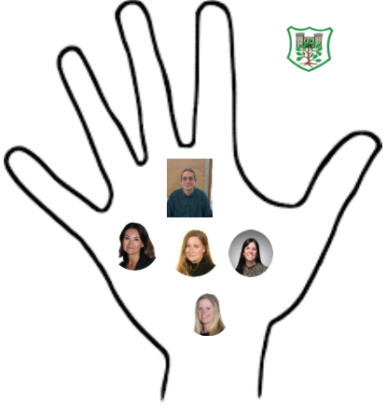
Safeguarding
Safeguarding is everyone's responsibility.
Mr Fisher- Designated Safeguarding Lead
Mrs Cracknell- Deputy Designated Safeguarding Lead
Miss Borgeat- Deputy Designated Safeguarding Lead
Mrs Richardson- Deputy Designated Safeguarding Lead
Mrs Sally Poole-Deputy Designated Safeguarding Lead

