Slide 1

Welcome to Year 1
Miss Deamer
Mrs Quinton
Miss Rumsey
Mrs Speed

Slide 2

What do you need for Year 1
Water bottle
Named clothing
OPAL- need wellies and rain clothes- out in all weather!
Uniform reminder
Reading books in everyday
Hair up if long

Slide 3
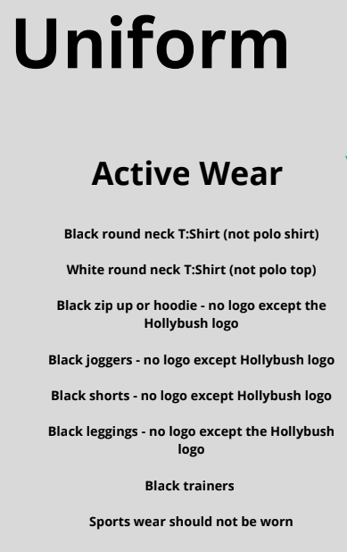
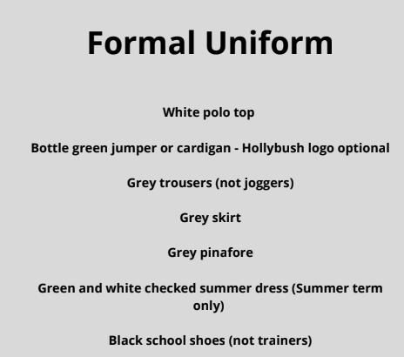
Hair longer than shoulder length must be tied back everyday.
Uniforms must not be mix and matched For example green jumpers must not be worn with black bottoms.

Slide 4

Google Classroom

Slide 5

PE days
PE days: Monday and Friday.
Activewear to be worn on these days.

Slide 6
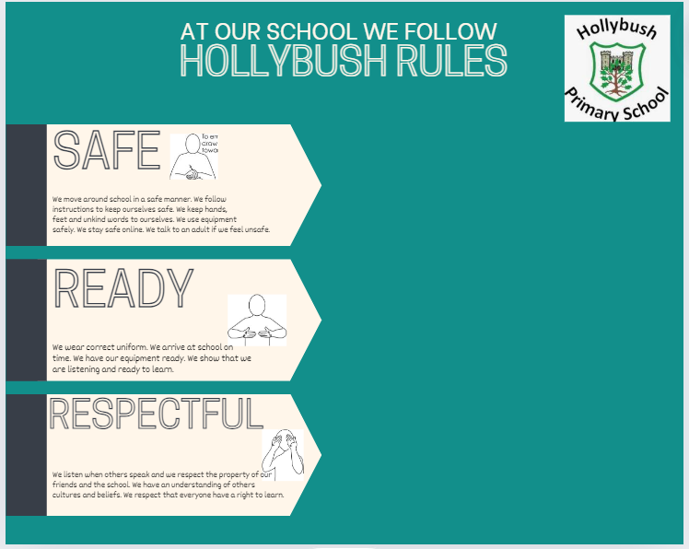
School Rules

Slide 7
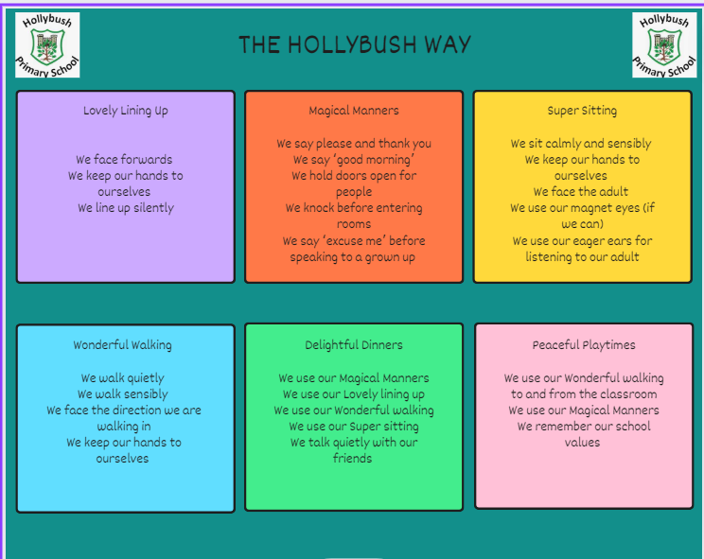
Behaviour

Slide 8

Values

Slide 9
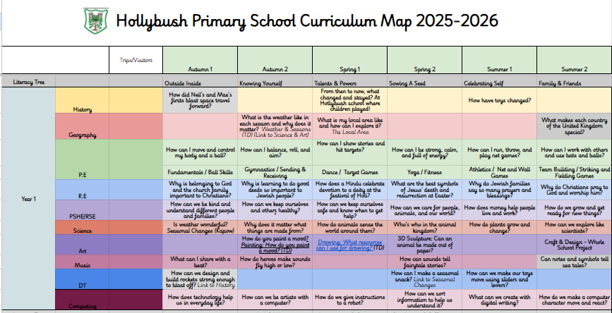
What will your child be learning?

Slide 10
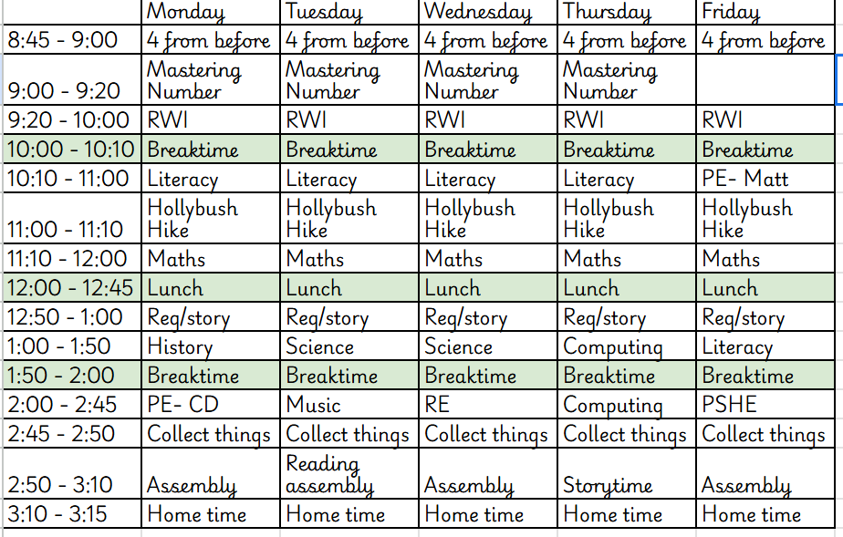
Timetable for this term

Slide 11
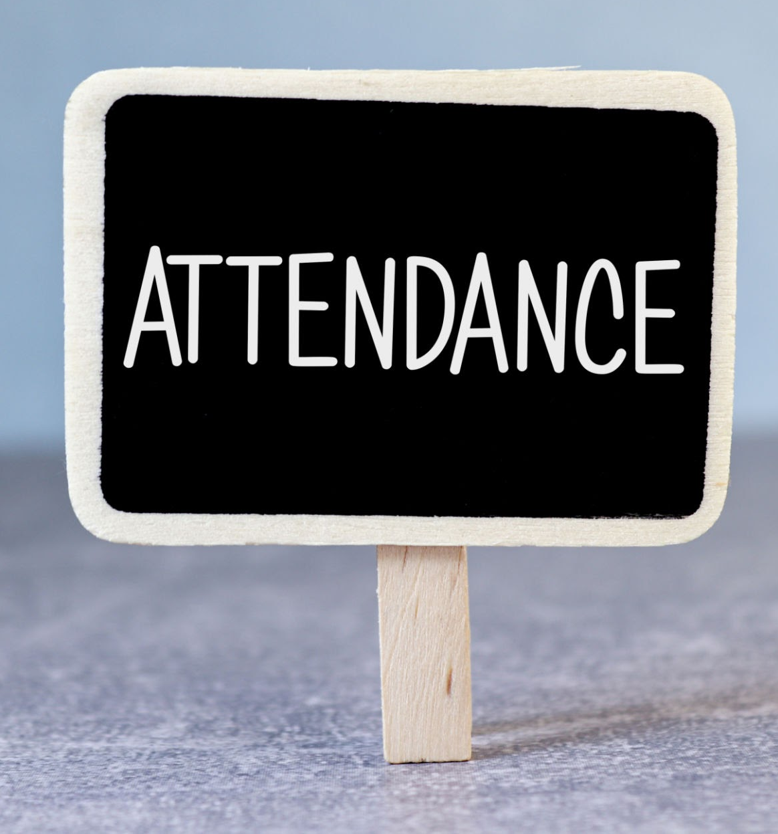

What can you do to support your child?
Attendance
Punctuality
Reading every night-with your child and to your child.
Ensure your child brings their book to school everyday, books are changed Monday and Friday. Please write in your child’s reading record when they read to you.

Slide 12

E-safety KS1
• Children must not publish images of other pupils
• Please ensure your child is using their device under your supervision
• Minimum ages for Instagram (13+), WhatsApp (16+), Facebook (13+),
Snapchat (13+)
• We will contact you if we suspect a pupil is misusing their device
• Talk about your child’s eSafety with them so they know they can come to
you or any school adult with problems
• It is important that pupils feel safe to discuss worries and that they will
not lose access to their device if they do make a mistake

Slide 13
How will we communicate with you?
Arbor - Key communications (e.g. daily messages, letters) and is also how you will make any necessary payments to the school.
Social Media – Like and follow Hollybush Primary School on Facebook and Instagram
Newsletter – The Hollybush Bulletin emailed home fortnightly
We will be available to speak to you before/ after school but please be aware this is often a busy time. We are always happy to call or email you or arrange a suitable time for a meeting (face to face or via phone call).
concerns - direct to us, please don’t use social media
Make sure we have up to date contact details

Slide 14
Other information
Cinema: Thursday 27th November
More to be confirmed
Tales Together 8:40am to 9am:
Friday 24th October
Friday 19th December
Friday 13th February
Friday 27th March
Friday 22nd May
Friday 17 July
Phonic test- June
Phonics play and learn- will be released soon

Slide 15
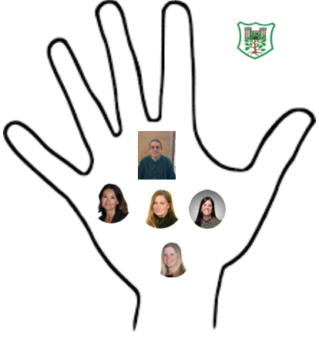
Safeguarding
Safeguarding is everyone's responsibility.
Mr Fisher- Designated Safeguarding Lead
Mrs Cracknell- Deputy Designated Safeguarding Lead
Miss Borgeat- Deputy Designated Safeguarding Lead
Mrs Richardson- Deputy Designated Safeguarding Lead
Mrs Sally Poole-Deputy Designated Safeguarding Lead

Slide 16

Any questions?
If so please feel free to come and see me anytime or email admin

