Slide 1




Year 6 SATs 2025

Slide 2
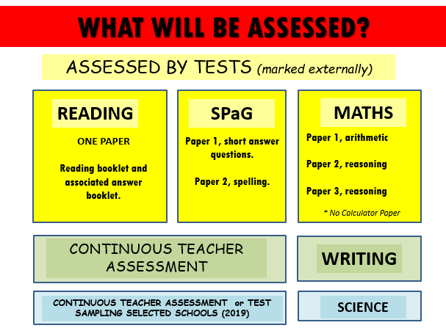


Slide 3
How do the tests take place?
The tests all take place in normal school time, under test conditions.
Pupils will not be allowed to talk to each other or communicate in any way during the tests.
The completed papers are sent away to be marked externally.
Results are returned to school in July.
The tests vary in length but last no longer than 60 minutes:
Reading: 60 minutes
Grammar, Punctuation & Vocabulary: 45 minutes
Spelling: 15 minutes
Arithmetic: 30 minutes
Mathematical Reasoning: 2 papers (40 minutes each).

Slide 4

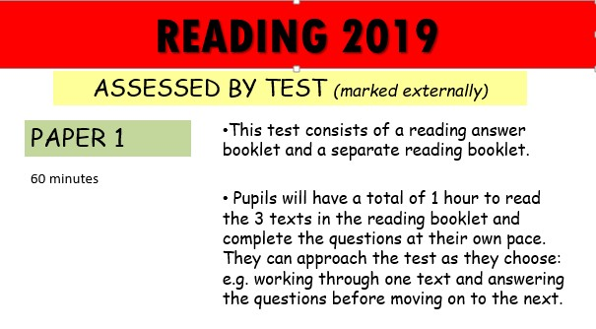

READING 2025

Slide 5

Reading Test
For this test there will be one reading booklet and one answer booklet.
The test will last for one hour (including reading time). There will be a total of 50 marks available.
There will be a range of texts including fiction, non-fiction and poetry. Marks will be awarded as follows:
Multiple choice or other selected responses: 10% - 30%
Short responses: 40% - 60%
Extended responses: 20% - 40%

Slide 6

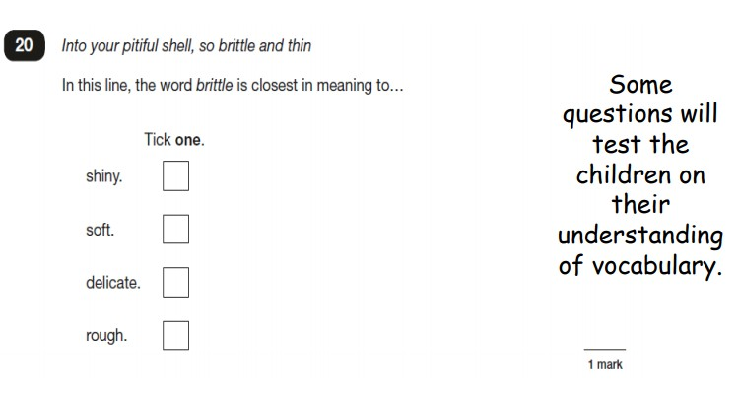
©Ks2history 2018

Slide 7

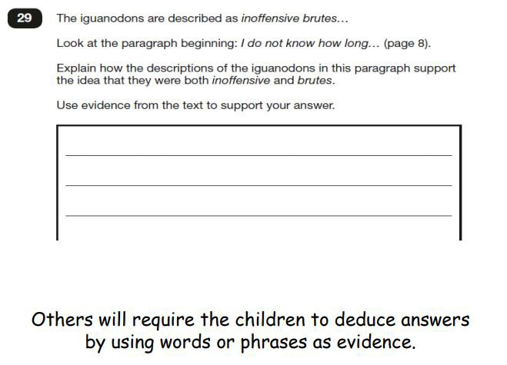
©Ks2history 2018

Slide 8
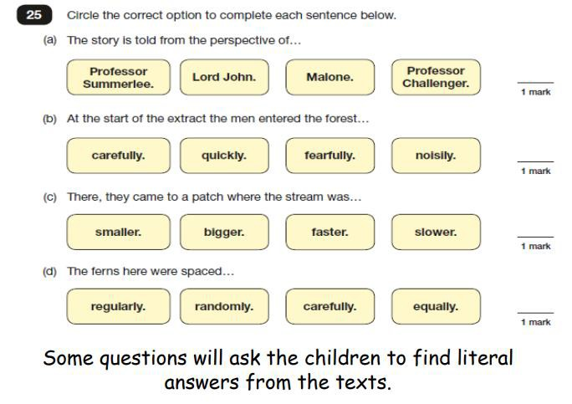
©Ks2history 2018

Slide 9
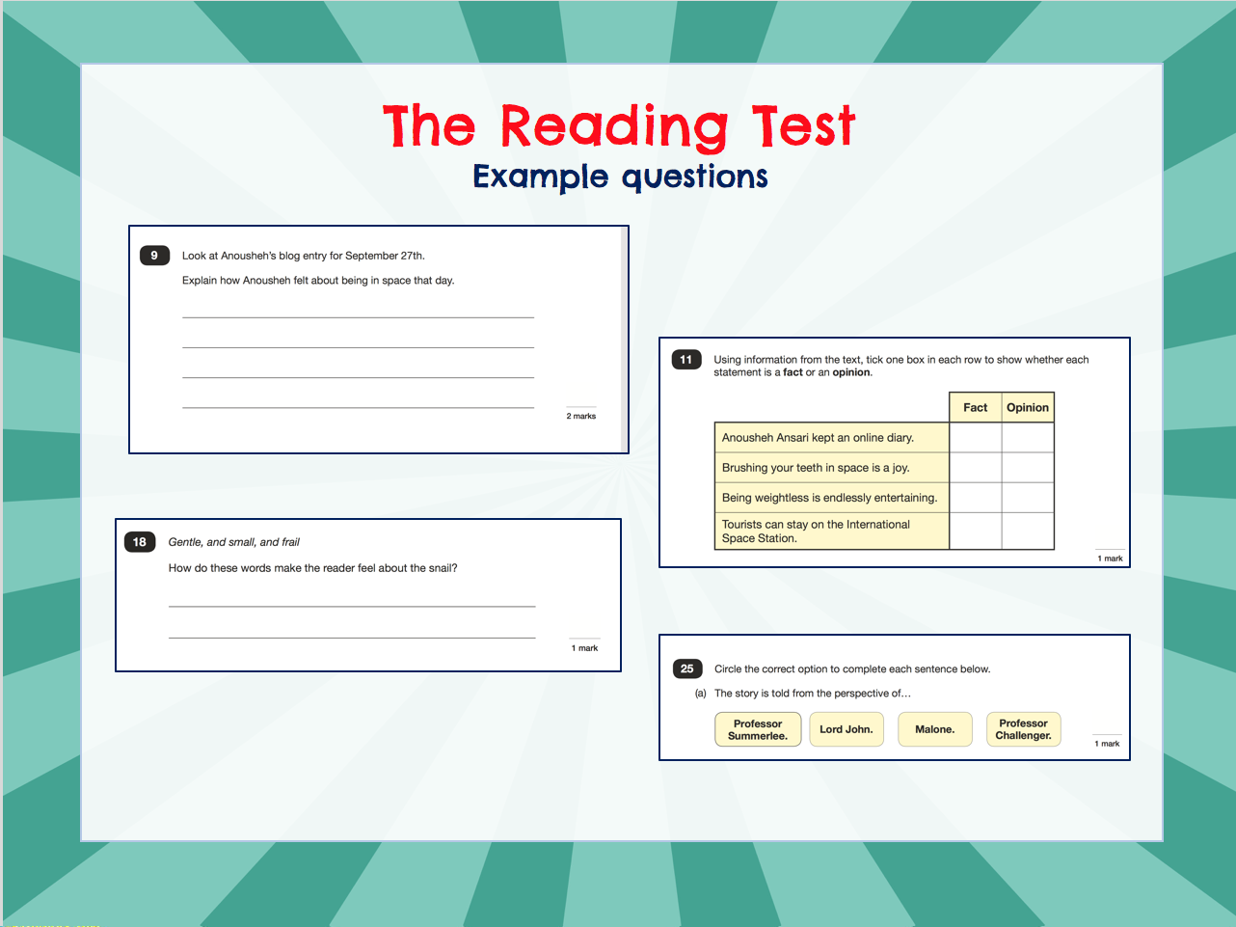
©Ks2history 2018

Slide 10
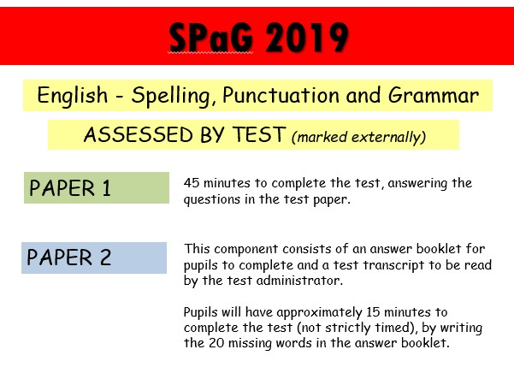


SPaG 2025
©Ks2history 2018

Slide 11

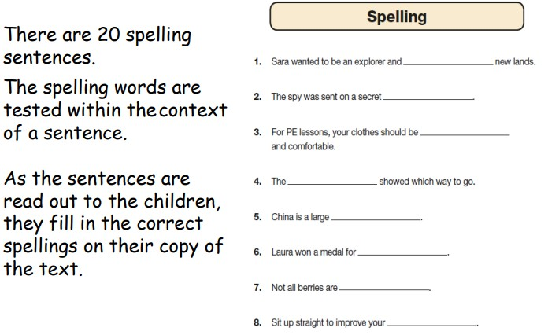
©Ks2history 2018

Slide 12

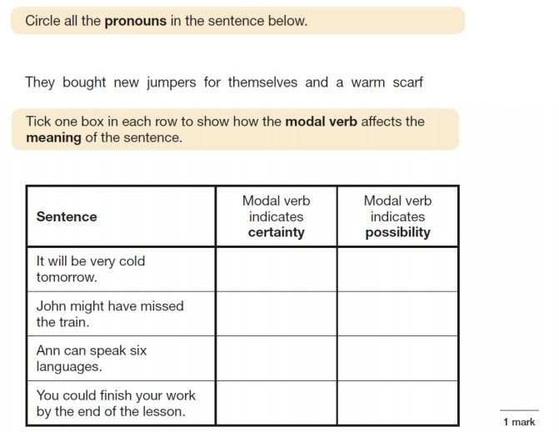
©Ks2history 2018

Slide 13
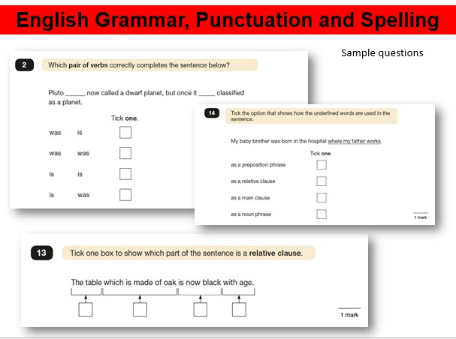
©Ks2history 2018

Slide 14
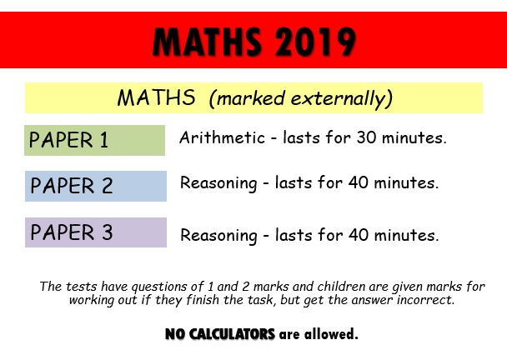


MATHS 2025
©Ks2history 2018

Slide 15
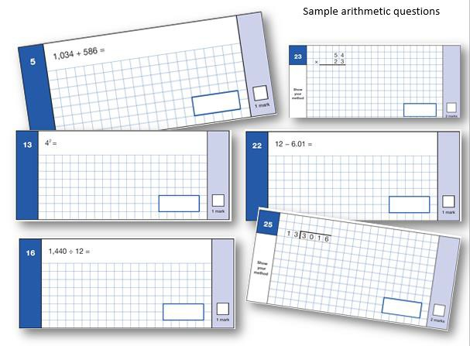
©Ks2history 2018

Slide 16
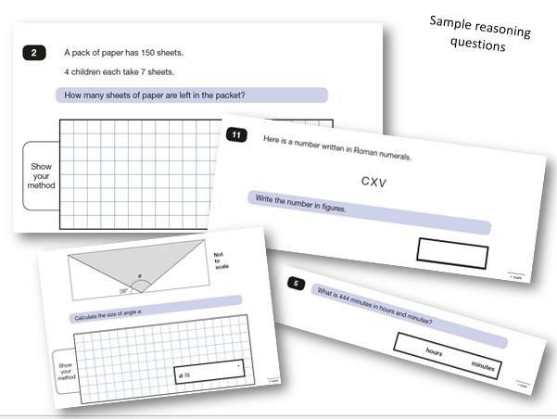
©Ks2history 2018

Slide 17
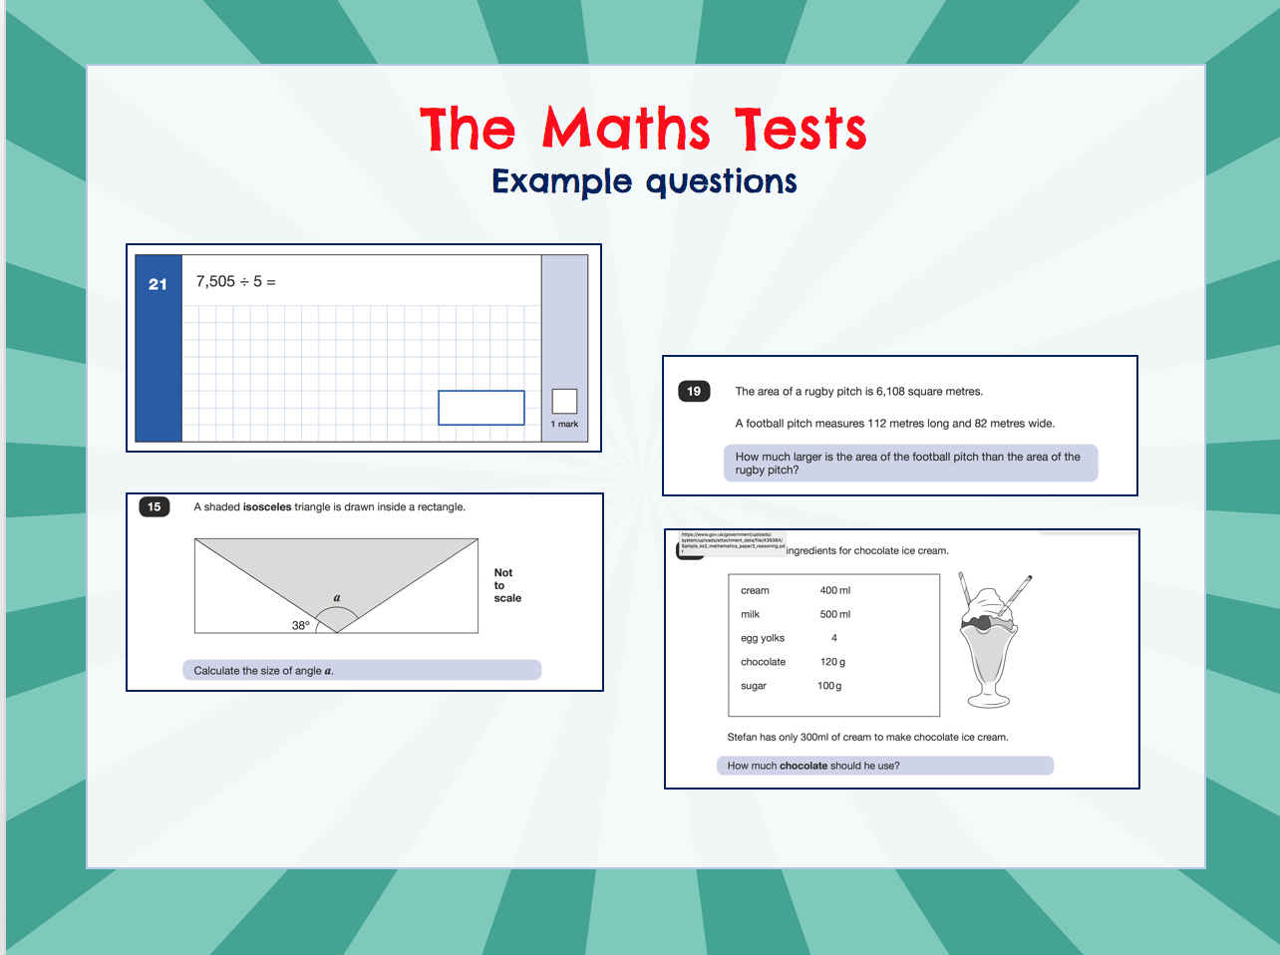
©Ks2history 2018

Slide 18
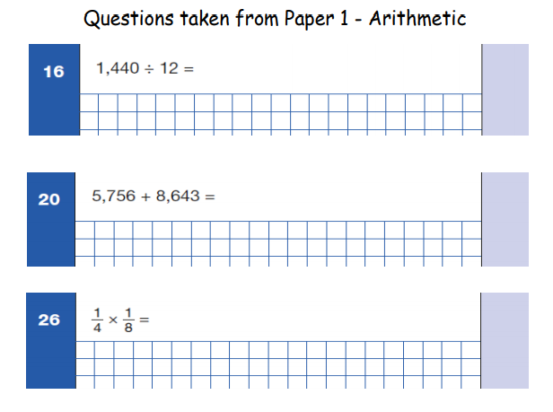

Slide 19
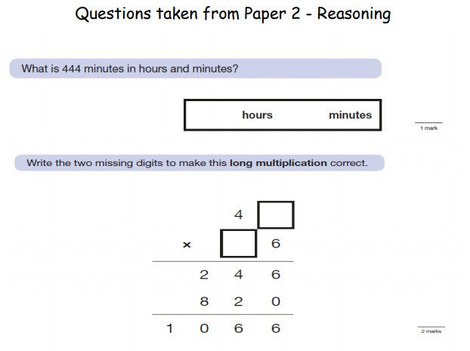

Slide 20
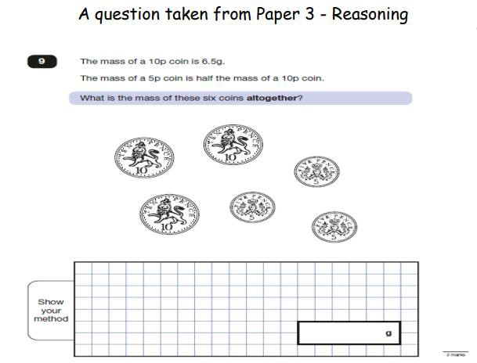

Slide 21
Other Assessments
There is no writing SATS test.
Writing assessment data will be formed from judgements made by the teacher, looking at evidence from writing collected over the course of the year.
The teacher will moderate their assessments with other professionals to make sure there is a consistent standard across the country.
Final judgements will be reported to parents at the same time as the other assessment results.
Science sampling has been discontinued by the government. Unless they change their minds, there will be no science sampling tests this year.

Slide 22
How can I help my child?
Help children not to feel worried or pressured about SATS. All that is asked is that they try their best. SATS should not be causing anxiety (not for children anyway). Do give lots of praise and encouragement!
Help children with organising their homework (including spellings and mental arithmetic) and support their reading for pleasure activities.
Help them to have early nights and a healthy diet.
Help your child to have the best possible attendance at school.
Please speak to a member of staff if you have questions or concerns.

Slide 23
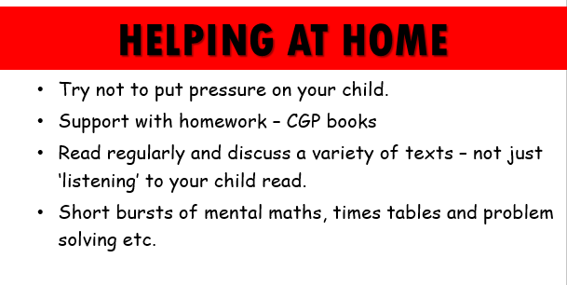
Times Tables Rockstars – x tables speed and accuracy is important!

Slide 24
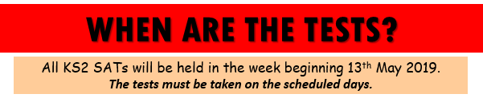
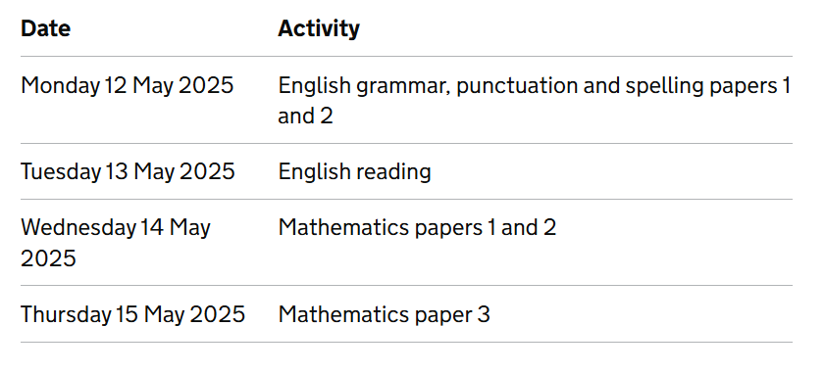
12th May 2025

Slide 25
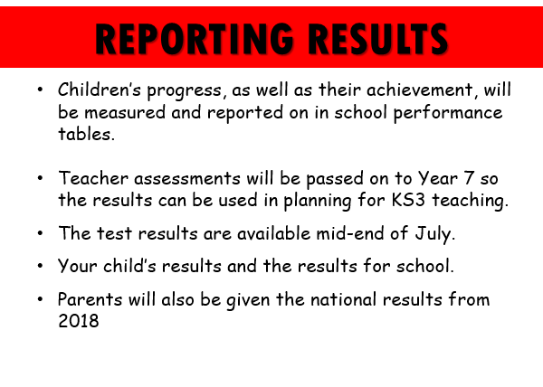
2024.

Slide 26


Slide 27
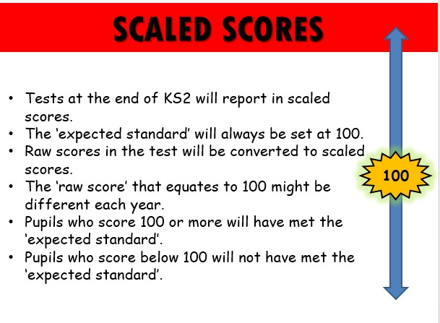

Slide 28
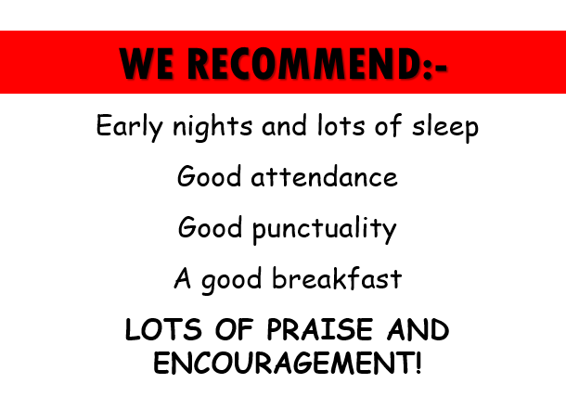

Slide 29

©Ks2history 2018

