Slide 1

RE at Hollybush 2024-25

Slide 2
There are many big questions we can ask about life, about what people believe, and if this knowledge has an impact on the life that we live. RE helps children to make sense of religion and belief, reflecting on their own ideas and ways of living.
As our school embraces diversity, we want our children and staff to promote and embed this through our school values and curriculum. Within Religious Education this means encouraging each other to ask big questions, aspiring to grow in knowledge about what people believe and how this makes a difference to how they live their lives.

Slide 3
Intent statement for RE
Our aim is to create a flexible, responsive curriculum which can be adapted to reflect children's interests and teachers' passions whilst ensuring rigorous progression and coverage of key skills and knowledge.
Religion and beliefs inform our values and are reflected in what we say and how we behave. RE is an important subject in itself, developing an individual’s knowledge and understanding of the religions and beliefs which form part of contemporary society.
Religious education provokes challenging questions about the ultimate meaning and purpose of life, beliefs about God, the self and the nature of reality, issues of right and wrong, and what it means to be human. It can develop pupils’ knowledge and understanding of Christianity, of other principal religions, other religious traditions and worldviews that offer answers to questions such as these.
RE also contributes to pupils’ personal development and well-being and to community cohesion by promoting mutual respect and tolerance in a diverse society. RE can also make important contributions to other parts of the school curriculum such as citizenship, personal, social, health and economic education, the humanities, education for sustainable development and others.
It offers opportunities for personal reflection and spiritual development, deepening the understanding of the significance of religion in the lives of others – individually, communally and cross-culturally.

Slide 4
Our curriculum
We have introduced The Emmanuel Project as our primary scheme of work. This focuses on key beliefs/concepts of six different faiths and a non-religious worldview, as the driver to get to the heart of faith and link together stories, practices, festivals and ways of life.
It follows an enquiry cycle model within each unit; engage, enquire, explore, evaluate and express. All the units expand the explore section into three areas scriptural text or narrative, community practice and daily living, to ensure a balanced approach to religious material, rather than an approach that focuses solely on religious festivals or sacred stories.
It utilises a key question, often including the key concept, as the title of the unit and more questions throughout to help structure the learning and activities.
What our curriculum looks like

Slide 5
Long Term Plan for EYFS (RE delivered flexibly according to the statutory requirements
of the EYFS framework and to help meet the Early Learning Goals)
Autumn 1 | Autumn 2 | Spring 1 | Spring 2 | Summer 1 | Summer 2
Why is the word ‘God’ so important to Christians? | Why do Christians perform nativity plays at Christmas? | How can we help others when they need it? | Why do Christians put a cross in an Easter garden? | What makes every single person unique and precious? | How can we care for our wonderful world?
CREATION 1 | INCARNATION 1 | SALVATION 2 | SALVATION 1 | INCARNATION 2 | CREATION 2
Including an encounter with … | Including an encounter with … | Including an encounter with … | Including an encounter with … | Including an encounter with … | Including an encounter with …
A Muslim whispering Allah in a baby’s ear | A Muslim story: Muhammad and the Ants | A Sikh story: Har Gobind and the 52 Princes | A Buddhist story: The Monkey King | Hindus celebrating at Raksha Bandhan | Tu be Shevat: the Jewish ‘Birthday of Trees’ Humanism – understanding our world

Slide 6
Long Term Plan for KS1 – these plans are flexible and responsive to individual needs and interests
Autumn 1 | Autumn 2 | Spring 1 |  | Spring 2 | Summer 1 | Summer 2
Christianity Baptism / church Why is belonging to God and the church family important to Christians? | Judaism Mitzvot / tzedakah Why is learning to do good deeds so important to Jewish people? | Christianity Parables / gospel What did Jesus teach about God in his parables? |  | Christianity Prayer / worship Why do Christians pray to God and worship him? | Christianity Emmanuel / Holy Spirit How does celebrating Pentecost remind Christians that God is with them always? | Judaism Tefillah/ blessings Why do Jewish families say so many prayers and blessings? Humanism – link to Thoughtful Thursday | Year 1
Autumn 1 | Autumn 2 | Spring 1 | Spring 2 | Summer 1 | Summer 2
Judaism Teshuvah / G-D Why do Jewish families talk about repentance at New Year? | Christianity Saviour / Jesus Why was Jesus given the name ‘saviour’? | Islam Allah / mercy How do some Muslims show Allah is compassionate and merciful? | Christianity Resurrection / joy What are the best symbols of Jesus’ death & resurrection at Easter? | Christianity Disciple / faith Why do Christians trust Jesus and follow him? | Judaism Torah / rabbi Why is the Torah such a joy for the Jewish community? Humanism – link to Thoughtful Thursday class assembly. | Year 2

Slide 7
Long Term Plan for Lower Key Stage 2 - these plans are flexible and responsive to individual needs and interests
Autumn 1 | Autumn 2 | Spring 1 | Spring 2 | Summer 1 | Summer 2
Christianity How do Christians show that reconciliation with God and others is important? | Islam How does a Muslim show their submission and obedience to Allah? | Hinduism Why do Hindus want to collect good karma? | Christianity Is the cross a symbol of love, sacrifice or commitment for Christians? | Christianity What do Christians mean when they talk about the Kingdom of God? | Judaism What symbols and stories help Jewish people remember their covenant with God? Humanism – link to Thoughtful Thursday class assembly. | Year 3
Autumn 1 | Autumn 2 | Spring 1 | Spring 2 | Summer 1 | Summer 2
Christianity How does believing Jesus is their saviour inspire Christians to save and serve others? | Islam Why do Muslims call Muhammad the ‘seal of the prophets’? | Hinduism How does the story of Rama and Sita inspire Hindus to follow their dharma? | Sikhism How does the teaching of the gurus move Sikhs from dark to light? | Christianity Why do Christians believe they are people on a mission? | Sikhism How do Sikhs put their beliefs about equality into practice? Humanism – link to Thoughtful Thursday class assembly. | Year 4

Slide 8
Long Term Plan for Upper Key Stage 2 - these plans are flexible and responsive to individual needs and interests
Autumn 1 | Autumn 2 | Spring 1 | Spring 2 | Summer 1 | Summer 2
Christianity Why is the gospel such good news for Christians? | Islam What does the Qur’an reveal about Allah and his guidance? | Hinduism What spiritual pathways to Moksha are written about in Hindu scriptures? | Judaism What is holiness for Jewish people: a place, a time, an object or something else? | Christianity What is the great significance of the Eucharist for Christians? | Buddhism How did Buddha teach his followers to find enlightenment? Humanism – link to Thoughtful Thursday class assembly. | Year 5
Autumn 1 | Autumn 2 | Spring 1 | Spring 2 | Summer 1 | Summer 2
Christianity How do Christians show their belief that Jesus is God incarnate? | Islam How does tawhid create a sense of belonging to the Muslim community? | Hinduism How do questions about Brahman and atman influence the way a Hindu lives? | Buddhism How does the Triple Refuge help Buddhists in their journey through life? | Christianity Should believing in the resurrection change how Christians view life and death? | Humanism Why do Humanists say happiness is the goal of life? | Year 6 or Year B

Slide 9
Assemblies, visits and visitors enhance our RE curriculum. We have close links to Hertford Baptist Church where we celebrate our Christingle each year. To encounter with people is vital for our pupils to engage with issues of faith, belief and worldviews, and to be able to explore more richly and deeply the ways of life of those different from themselves, both what makes them different and what we hold in common. Visits and visitors are therefore an important element in the provision of RE.
The Faith communities directory, within the Herts Grid for Learning, offers a directory and guidance for our school to make connections with, appropriate for each unit undertaken. We also make links to our school community, allowing families to celebrate their faiths and beliefs with us.
Religious education, collective worship and SACRE also offer the following support and resources to enhance the delivery of our RE curriculum.
Hertfordshire Standing Advisory Council on Religious Education (SACRE)
Hertfordshire Agreed Syllabus for Religious Education
Hertfordshire Agreed Syllabus for Religious Education: support materials and resources
Collective worship
RE subject leaders
Visits and visitors
RE news
Newsletters and networking
Contacts
Training
Religions and worldviews

Slide 10
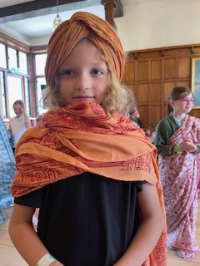
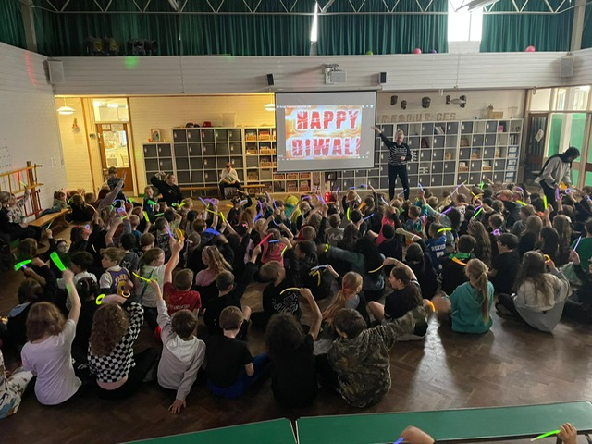
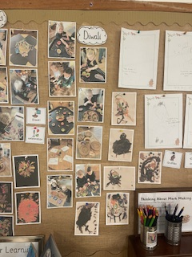
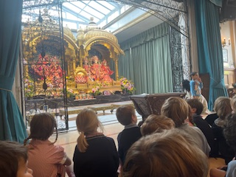
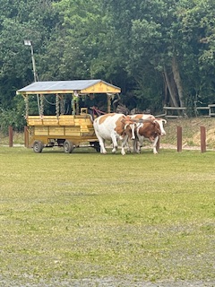
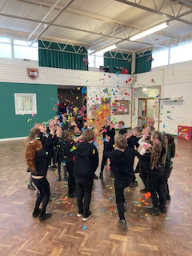
RE Events
The children in our school take part in a range of events and learning opportunities that link to their work in Religious Education. Here you will find continual updates, examples of work and photos of these events.
Diwali assembly
EYFS Diwali
Year 3 Temple visit
Celebrating Holi

