Slide 1

Religious Education at Hollybush School
October 2023

Slide 2
Purpose of Study
RE aims to enable pupils to become religiously, theologically and philosophically literate so they can engage in life in an increasingly diverse religious and secular society. It is not about telling pupils what views they should have but rather assists them in gaining shared human understanding, developing personal identity and searching for meaning in the context of evaluating different viewpoints. Teaching this subject needs to provide pupils with a systematic knowledge and understanding about Christianity, principal religions and worldviews, which guide people through life.

Slide 3
Religious Education - Aims
RE aims to ensure that all pupils develop knowledge and understanding of sources of wisdom and their impact whilst exploring personal and critical responses.
Sources of wisdom from religions and worldviews and their impact All pupils should:
Know, understand and explore the significance and impact of sacred texts, other sources of wisdom and ways of expressing meaning
Express ideas and insights about the nature of beliefs, values and practices and their impact on the identity of individuals and communities locally, nationally and globally
Recognise and explore similarities and differences which exist within and between religious and non-religious worldviews
Personal and critical responses to religion and worldviews All pupils should:
Express with increasing discernment their personal reflections, critical responses and connections to faith and belief enquiring into and responding to spiritual, philosophical, moral and ethical issues
Engage with the questions and responses offered by religions and worldviews concerning ultimate questions and human responsibility
Develop the skills required to engage with others in dialogue and to cooperate in society with respect and compassion
By the end of each Key Stage, pupils are expected to know, apply and understand the matters, skills and processes specified in the relevant statutory programme of study.
RE is concerned with “learning about religions” and “learning from religion” and it is not the practice of this school to preach to or convert the children. The faith background of both the staff and child’s family is respected at all times.
At this school it is our practice to talk to parents to ensure that they understand the aims and value of the RE curriculum before honouring the right of withdrawal from RE. Any parent who wishes to withdraw their child is expected to consult the headteacher.

Slide 4
Continuity and Change
The new Hertfordshire Agreed Syllabus 2023-28 builds on the most recent national developments in RE, in particular the Commission on RE Report 2018, which advocates a ‘Worldviews Approach’. Worldviews are not restricted to propositional belief, but also include behavioural, experiential and attitudinal dimensions of what it means to be human.
“A worldview is a person’s way of understanding, experiencing, and responding to the world. It can be described as a philosophy of life or an approach to life. This includes how a person understands the nature of reality and their own place in the world. A person’s worldview is likely to influence and be influenced by their beliefs, values, behaviours, experiences, identities and commitments.” (Religion and Worldviews: The Way Forward p4)

Slide 5
Continuity and Change
The Agreed Syllabus structure (with additional support materials) enables teachers to develop creative and challenging learning experiences that introduce pupils to powerful knowledge from the world’s religions, beliefs and cultures and how this knowledge is explored, and in so doing, gain a greater understanding of themselves as well as of others and of the world.
This Syllabus:
Ensures that all pupils develop knowledge and understanding of sources of wisdom and their impact whilst exploring personal and critical responses
Provides eight Key Areas of study (slide 10) through which to plan the subject content and to devise key questions and enquiries
Encourages schools to spend an appropriate proportion of their time allocation for RE reflecting the background of their own pupils whilst ensuring a broad and balanced RE curriculum that reflects the diversity within as well as between institutional religions and worldviews
Offers a flexible model of progression through expected learning outcomes at each Key Stage to support school assessment procedures
Enables teachers to recognise what it means to be ‘religiously, theologically and philosophically literate’ at each Key Stage
Engages pupils both academically and personally.

Slide 6
Time Allocation for RE
In line with the requirements of the Hertfordshire Agreed Syllabus of Religious Education 2023-2028:
RE must be taught at identifiable times in every year group
It is a legal requirement for all pupils on the school register to have RE
It is not a requirement for pupils in nursery schools or nursery classes, but the Early Years and Foundation Stage (EYFS) curriculum must promote pupils’ spiritual, moral, social and cultural development
This Syllabus requires a minimum allocation of curriculum time distributed throughout the Key Stage for Key Stages 1 and 2. This gives schools the opportunity to be flexible in their approach to planning
Flexible delivery can complement the regular programme of timetabled lessons. This may include a creative or cross-curricular approach to planning and delivery for whole school approaches such as a themed day or week for RE.
These minimum time requirements include visits and RE curriculum days but not school productions related to festivals or collective worship time
EYFS RE delivered flexibly according to the statutory requirements of the EYFS Framework and to help meet the Early Learning Goals
KS1 60 hours over 2 years (approximately 10 hours per term)
KS2 156 hours over 4 years (approximately 13 hours per term)

Slide 7
The RE Curriculum
Religious Education is unique in the school curriculum in that it is neither a core nor a foundation subject, but it is a statutory requirement that RE is taught in all primary schools.
It is the intent of Hollybush Primary School that Religious Education promotes an enquiry-based approach through the implementation of the Hertfordshire SACRE Agreed Syllabus 2023, which covers Early Years and Foundation Stage, Key Stage 1 and 2.
How we do this
The learning objectives of the RE Agreed Syllabus are achieved through the following ways:
handling artefacts
exploring sacred texts
using imaginative play or drama to express feelings and ideas
responding to images, games, stories, art, music and dance
meeting visitors from local religious communities
making visits to religious places of worship where possible, and where not, making use of videos and the internet
taking part in whole school events (Christingle service, significant day assemblies, multi-faith days, Harvest Festival, school performances)
participating in moments of quiet reflection
participating in assemblies
using ICT to further explore religion and belief globally
comparing religions and worldviews through discussion
debating and communicating religious belief, world views and philosophical ideas, and answering and asking ultimate questions posed by these.

Slide 8
Early Years Foundation Stage
Pupils are introduced to Christianity as the ‘heritage religion’ and the one that most influences school and community life. They are taught about traditions, beliefs and worldviews outside of their own experiences through exploring other cultures and practices in the wider world. Where pertinent, the different religious faiths and experiences and celebrations of classmates are drawn upon.
Content and approach
In line with the legal requirements and the 2023 Herts SACRE Agreed Syllabus, more time is spent on Christianity than on any other religion or worldview, “to reflect the fact that the religious traditions in Great Britain are in the main Christian” (Education Act 1988).
Principal religions represented in Great Britain are usually regarded as: Buddhism, Islam, Judaism, Hinduism and Sikhism.
Other religions and non-religious worldviews may include: the Baha’i faith, Church of Jesus Christ of Latter Day Saints, Jehovah’s Witnesses, Rastafarians, Pagans, Hare Krishnas, African churches, Humanists and Atheists.

Slide 9
Foundation Stage
Foundation stage must have the opportunities to learn about Christianity and other religions represented in the class. They celebrate a range of different festivals throughout the year and build on topic work as appropriate.
Key Stage One
Christianity and at least one other Abrahamic religion are to be studied in depth (Judaism and/or Islam), or the predominant additional principal faith represented in the school. Pupils may also learn from other religions and worldviews in thematic units.
Lower Key Stage Two
Christianity and at least two other principal faiths are to be studied in depth, one Abrahamic and one Dharmic. (Recommended focus faiths for lower KS2 – Christianity, Islam, Hinduism or Sikhism). Pupils may also learn from other religions and worldviews in thematic units
Upper Key Stage Two
Christianity and at least two other principal faiths are to be studied in depth, one Abrahamic and one Dharmic. (Recommended focus faiths for upper KS2 – Christianity, Judaism, Hinduism or Buddhism). Pupils may also learn from other religions and worldviews in thematic units.
Abrahamic Faiths (from the line of Abraham) Judaism, Christianity, Islam Dharmic traditions (sharing the concept of Dharma) Sanatana Dharma (‘Hinduism’), Buddhist Dhamma (‘Buddhism’), Sikhi (‘Sikhism’)

Slide 10
The ‘five keys’ RE planning model for SEND
The Hertfordshire Agreed Syllabus recommends that special schools use the following model devised by Anne Krisman12, teacher at Little Heath School, London Borough of Redbridge. (Due to the high intake of SEND pupils at Hollybush this is worth considering when planning lessons)
1. Connection – what links can we make with our pupils’ lives? Creating a bridge between pupils’ experiences and the religious theme
2. Knowledge – What is the burning core of the faith? Selecting what really matters in a religious theme, cutting out peripheral information
3. Senses – What sensory elements are in the religion? Looking for a range of authentic sensory experiences that link with the theme
4. Symbols – What are the symbols that are most accessible? Choosing symbols that will encapsulate the theme
5. Values – What are the values in the religion that speak to us? Making links between the values of the religious theme and the children’s lives
A more detailed explanation of Anne Krisman’s approach, with supporting examples, can be found here: http://www.reonline.org.uk/news/5-keys-into-re/

Slide 11
The 8 Key Areas
The programmes of study set out eight Key Areas which aim to enable pupils to develop knowledge and understanding of sources of wisdom and their impact whilst exploring personal and critical responses.
Developing religious, theological and philosophical literacy through religions and worldviews permeates all Key Areas of the programmes of study. The following eight Key Areas of RE may be taught in any order:
Beliefs and practices Sources of wisdom Symbols and actions
Prayer worship and reflection Identity and belonging Ultimate questions
Human responsibility and values Justice and fairness
All eight areas of the programmes of study must be visited across each Key Stage.

Slide 12
Curriculum impact
By the end of each key stage, pupils are expected to know, understand and apply skills related to targets and learning themes embedded with the Herts SACRE Agreed Syllabus (page 20, section 4 Progression and assessment 4.1 – 4.5)
RE is reviewed on a termly basis by the subject leader, who also carries out learning walks, book scrutinies and lesson observations. The impact of our RE curriculum is also sought directly from the pupils: surveys and questionnaires are used to gather pupil voice on this subject. This information is used to further develop the RE curriculum.

Slide 13
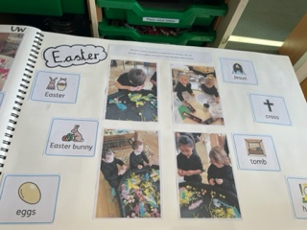
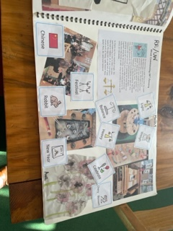
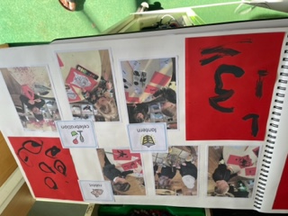
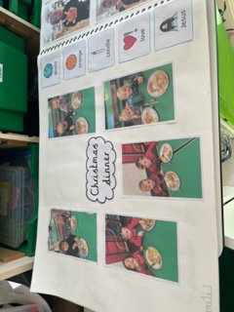
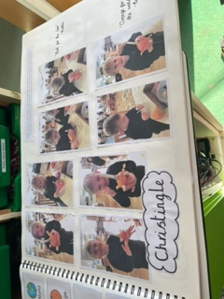
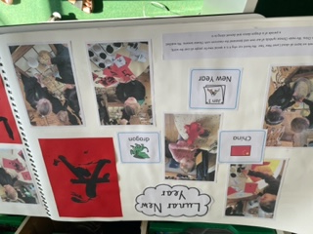
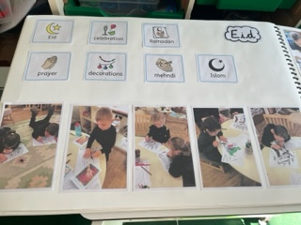
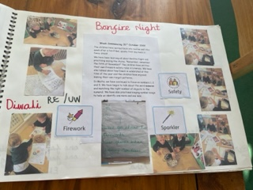
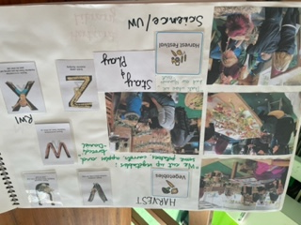
Floor books
2022-23

