Slide 1
Online Safety Presentation
Hollybush Primary School
30.11.2022

Slide 2
The internet can be a powerful force for good.

Slide 3
… but illegal and harmful content and activity is widespread online. 62% of adult internet users and over 80% of children (aged 12-15) have had potentially harmful experiences online.
In 2020, nearly 22 million reports of child sexual exploitation were made to the National Centre for Missing and Exploited Children, including over 65 million images, videos and other files. Online platforms can be a tool for abuse and bullying, and the impact of harmful content and activity is particularly damaging for children.
Online Safety Data Initiative, UK GOV

Slide 4
In a recent survey carried out by Ofcom it was reported that six in ten children aged 3-17 (57%) used live streaming platforms to watch online content. A much lower proportion of children streamed their own videos in real time for others to watch (15%). The research found that the platforms used most to watch live streams were YouTube and TikTok.
Data source: Ofcom Children and Parent: media use and attitudes report 2022

Slide 5
For many of us, we see our online lives and offline lives as different, but children are growing up with technology and the internet and for them there isn’t a difference; online life and offline life is just life.
NSPCC website

Slide 6


Slide 7

What are the risks for children online?

Slide 8

What might they see?
When they’re playing a game, using an app, watching YouTube channels, what sort of content is there? Have they seen any inappropriate content and if so, what did they do? How did it make them feel?

Slide 9

Most games and social media apps have various communications features, from text chat to voice chat, messaging and private messaging, video and image sharing, livestreaming and more. Ask about the friends they play with. What is the difference between online and offline friends? Do they talk to people they don’t know online? If so, why and what are they sharing?
Who they might speak to?

Slide 10
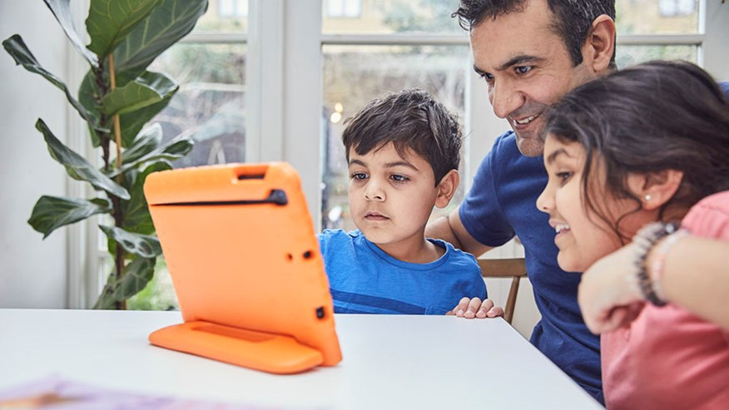
Talking regularly with your child is the greatest tool to help keep them safe online. Talking regularly and making it part of daily conversation, like you would about their day at school, will help your child feel relaxed. It also means when they do have any worries, they’re more likely to come and speak to you.

Slide 11
Age-appropriate conversations (CEOP & PANTS)

Slide 12
Age-appropriate conversations (CEOP & PANTS)
NSPCC online safety advice – 0808 800 5000

Slide 13
Age-appropriate conversations (CEOP & PANTS)
NSPCC online safety advice – 0808 800 5000
Tackling difficult conversations (NSPCC)

Slide 14
Age-appropriate conversations (CEOP & PANTS)
NSPCC online safety advice – 0808 800 5000
Tackling difficult conversations (NSPCC)
Be informed – online games

Slide 15
Age-appropriate conversations (CEOP & PANTS)
NSPCC online safety advice – 0808 800 5000
Tackling difficult conversations (NSPCC)
Be informed – online games
Parental controls
Jessie and friends

Slide 16

NSPCC

Slide 17
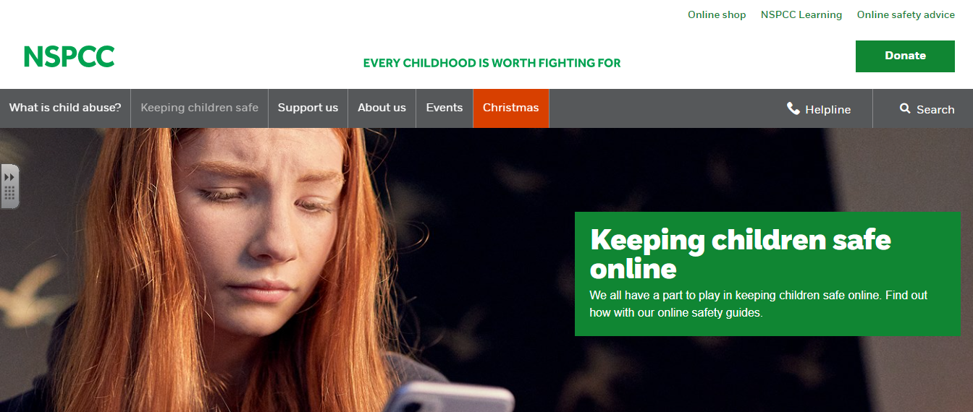
NSPCC online safety hub

Slide 18

Technology continues to move at a fast rate – stay up to date!

Slide 19
How do you keep your children safe online?

Slide 20
How do you keep your children safe online?
Any Questions?

